Slide 1
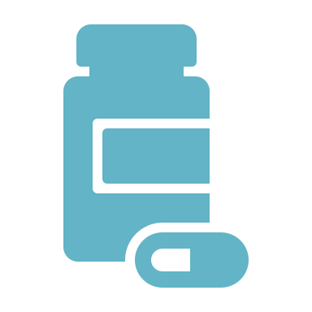
Opioid Awareness

Slide 2
What is an Opioid?
Class of drug used for pain relief
Highly addictive
Includes Vicodin, Percocet, Oxycontin and others
Gateway drug to heroin

Slide 3
How Did the Crisis Begin?
Opioids were improperly marketed to the community as an effective, non-addictive method for treating pain
Patients prescribed far too many pills and/or refills, resulting in addiction
Number of opioids in circulation grew, as did misuse in households and the community
Physicians began prescribing less opioids which decreased the amount in circulation
Resulted in victims of the addiction turning to heroin and other street drugs

Slide 4
Result: Overdose Deaths of Prescription Opioids
Prescription opioids without other synthetic narcotics have seen a decline
Prescription opioids and other synthetic narcotics exhibit an increase
Fig. 3. National Drug Overdose Deaths Involving Prescription Opioids- Number Among All Ages, 1999-2017 (Source: CDC WONDER)

Slide 5
Result: Overdose Deaths Involving Any Opioid
Both male and female have seen a steady increase
Based on the graph, consistently more prominent in males than females
Fig. 4. National Drug Overdose Deaths Involving Any Opioid- Number Among All Ages, by Gender, 1999-2017 (Source: CDC WONDER)

Slide 6
What Can be Done?
Store
Properly store prescriptions
Educate
Know the signs of an overdose
Dispose
Properly dispose of excess opioids
Support
Provide support and resources for those affected

Slide 7
Store and Dispose
Safe Storage:
Keep medication in the container in which it was received
Lock container in cool, dry place out of reach from children
Safe Disposal:
There are specific websites that specialize in safe drug disposal (Disposemymeds.org)
Walgreens Safe Disposal Bins (visit website for locations)
Proper disposal recipes for home and other resources on FDA website

Slide 8
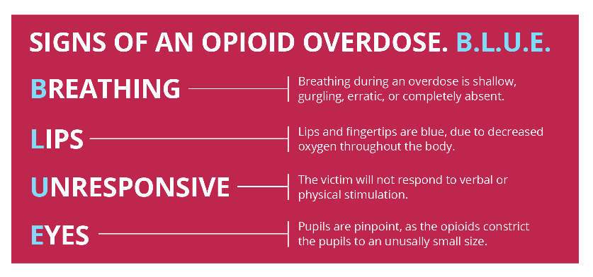
Educate. Know the Signs of an Overdose
Knowing the signs of an overdose could potentially help to save a life
If you or others experience these signs, call 911 immediately
If available, safely and responsibly administer Narcan
Narcan is available at most pharmacies without a prescription and without needing to provide personal information
Fig. 3. : “Rady Children's Hospital San Diego.” Rady Children's Hospital San Diego, https://www.rchsd.org/programs-services/pain-management/recognizing-overdose-what-to-do/.

Slide 9
Provide and Support
https://www.drugabuse.gov/patients-families
Helpful website for those struggling with opioid addiction
Provides treatment resources for teens, young adults, and adults
Also provides information for those with friends or family members dealing with addiction
Wayne State University CHC
Wayne State University Campus Health Center
Open Monday-Friday from 9:00am-5:30pm
Great resource for students concerned about opioid abuse
Staff readily available to help on the road to recovery
CAPS at Wayne State University
Counseling and Psychological Services for students
Whether you or someone you know needs to talk, CAPS is a great resource for those struggling with opioid abuse

Slide 10
Antibiotic Awareness

Slide 11
What is an Antibiotic?
Medicine used to treat or prevent infections by killing or slowing the growth of bacteria in the body
Treats bacterial infections including strep throat, pink eye, ear infections, and more
Cannot fight viral infections such as cold, flu, and most coughs
Anytime an antibiotic is used, antibiotic resistance can occur

Slide 12
What is Antibiotic Resistance?
Urgent public health crisis
Antibiotic resistance takes place when bacteria develop the ability to defeat the drugs that were designed to destroy them
Causes infections that were once treatable to become untreatable
Caused by the misuse and overuse of antibiotics
Antibiotic resistance can spread

Slide 13
Fig. 4. :“MARR: Michigan Antibiotic Resistance Reduction Coalition.” MARR: Michigan Antibiotic Resistance Reduction Coalition, http://mi-marr.org/info-about-antibiotic-resistance.php.

Slide 14
Fig. 5. : “MARR: Michigan Antibiotic Resistance Reduction Coalition.” MARR: Michigan Antibiotic Resistance Reduction Coalition, http://mi-marr.org/info-about-antibiotic resistance.php.

Slide 15
How you can help
What can the people using healthcare do to prevent the spread of antibiotic resistance?
Take antibiotics only when prescribed by a certified healthcare professional
Do not hesitate to ask healthcare provider whether antibiotics are necessary
Do not pressure healthcare provider to prescribe antibiotics unless the infection is caused by bacteria
If prescribed, always complete the full prescription even if symptoms of illness subside
Educate yourself and others about antibiotic resistance

Slide 16
How healthcare professionals can help
How can healthcare professionals help prevent the spread of antibiotic resistance?
Limit prescriptions of antibiotics to only when it is likely to benefit the patient
Prescribing “narrow spectrum” antibiotics that target specific bacteria most likely causing patient illness
Strongly encourage and educate patients to use antibiotic as instructed

Slide 17
Resources for antibiotic resistance Awareness
The Centers for Disease Control and Prevention (CDC) Website
https://www.cdc.gov/drugresistance/index.html
Great resource for information on antibiotic resistance
Michigan Antibiotic Resistance Reduction (MARR)
http://mi-marr.org/
Information and educational programs and resources for students, healthcare users, healthcare providers and more

Slide 18
References
https://www.drugabuse.gov/related-topics/trends-statistics/overdose-death-rates
http://mi-marr.org/index.php
https://www.cdc.gov/drugresistance/index.html
https://www.who.int/mediacentre/commentaries/stop-antibiotic-resistance/en/
https://www.cdc.gov/antibiotic-use/community/about/antibiotic-resistance-faqs.html
https://www.cdc.gov/drugresistance/protecting_patients.html
https://againstopioidabuse.org/about-us/

