Slide 1
Vaping
Presented by:
Campus Health Center

Slide 2
Vaping and E-cigarettes
Vaping is the act of inhaling and exhaling aerosol produced by e-cigarettes or other devices
E-cigarettes are battery operated devices that individuals use to inhale an aerosol, which typically contains nicotine, flavoring and other chemicals.
Known as electronic nicotine delivery systems (ENDS)

Slide 3
Main Components
E-cigarettes mainly contain four components
A liquid chemical, referred to as e-juice
Cartridge
Battery, the power source
Atomizer, which is a heating element

Slide 4
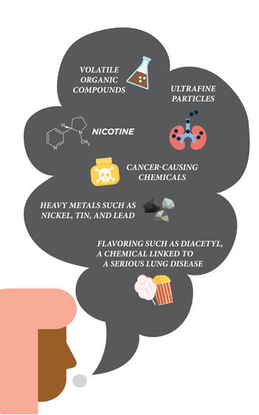
E-Liquid
The main component of e-cigarettes is the e-liquid or e-juice
Contains nicotine, propylene glycol, glycerin,, flavorings, heavy metals and other chemicals that are harmful

Slide 5
E-Cigarettes: Nicotine and Flavorings
Nicotine is a stimulant drug that speeds up the messages traveling between the brain and body.
Very addictive substance found in tobacco products
E-cigarettes come in many flavorings, such as mint, bubble gum, cotton candy, and with fruit flavors being the most popular among youth
Can increase the risk of cardiovascular disease when inhaled

Slide 6
Names and Shapes
E-cigarettes come in a variety of names and shapes, such as:
E-cigs
E-hookahs
E-pipes
Vapes or vape pens
Resembling USBs

Slide 7
Who is using E-cigarettes?
Mostly common among the youth population
High school students are using e-cigarettes more than any other tobacco product
As of 2019, around 5.3 million U.S. students are using e-cigarettes
1 out 10 middle school students (10.5%)
1 out 4 high school students (27.5%)

Slide 8
Growth Trends
E-cigarettes use have increased among the youth population in the past years
Use among high school students increased from around 12% to 22% in the years 2017 and 2018
There's a lower percentage of middle school students using e-cigarettes than high school students

Slide 9
Adult use of E-cigarettes
The younger adult population is using e-cigarettes more often

Slide 10
What is JUUL®
A brand of e-cigarettes that’s popular among the youth and young adult population
JUULs resemble USB flash drives
JUUL pods contain nicotine salts and they don’t produce vapor when the device is used
One JUUL pod contains contains 20 cigarettes of nicotine – that’s one pack of cigarettes

Slide 11
JUUL®
A JUUL with pods in different flavors

Slide 12
Outbreaks
CDC, Food and Drug Administration, state and local department and other public health organizations are investigating outbreaks of e-cigarette, or vaping, product use associated lung injuries (EVALI)
As of December 2019:
2,561 EVALI cases were reported to the CDC from all over the country
Out of the EVALI cases reported, 55 deaths have occurred
Laboratory findings show that vitamin E acetate is associated with the EVALI outbreak
Vitamin E acetate is an additive in THC-containing e-cigarette products

Slide 13
Known Health Effects
Due to containing nicotine, it can be quite addictive, affecting the development of fetuses and adolescent’s brain, which continues into their mid-20s.
It affects areas of the brain that are responsible for attention, memory, learning, and brain plasticity

Slide 14
Know Health Effects
Lung related illnesses include symptoms such as:
Coughing
Shortness of breath
Chest pain
Gastrointestinal symptoms
Nausea
Vomiting
Stomach pain

Slide 15
What Can We Do?
Talk with young people
Have a conversation with children and teenagers about the risks and dangers of using e-cigarettes
Explain what nicotine is and how it harms their brain development. Talk about nicotine addiction with them
Reduce young people’s exposure to e-cigarettes
If you use e-cigarettes or know someone who does, don’t allow them to be used in front of them
Lead by example and they will learn and follow your positive behaviors
Talk to your health care provider
To get reliable and credible information, speak with your provider to educate your children on the health risks

Slide 16
References
About Electronic Cigarettes (E-Cigarettes). (2019, November 26). Retrieved December 10, 2019, from https://www.cdc.gov/tobacco/basic_information/e-cigarettes/about-e-cigarettes.html.
E-Cigarettes and Lung Health. (n.d.). Retrieved December 10, 2019, from https://www.lung.org/stop-smoking/smoking-facts/e-cigarettes-and-lung-health.html.
Know the Risks: E-cigarettes & Young People: U.S. Surgeon General's Report. (n.d.). Retrieved December 27, 2019, from https://e-cigarettes.surgeongeneral.gov/default.htm.
Outbreak of Lung Injury Associated with the Use of E-Cigarette, or Vaping, Products. (2019, December 6). Retrieved December 10, 2019, from https://www.cdc.gov/tobacco/basic_information/e-cigarettes/severe-lung-disease.html.
What We Know About Electronic Cigarettes: Smokefree. (n.d.). Retrieved December 10, 2019, from https://smokefree.gov/quit-smoking/ecigs-menthol-dip/ecigs.

