Slide 1
Stress
What You Need to Know
and
How to Cope with It
Notes:
Today we will be talking about stress in college students, how it affects your body, how to cope with it, and campus resources you can utilize if you find that you are feeling really stressed out.

Slide 2
Before We Start…
A quick stress ball activity

Slide 3
What is Stress?
Stress is a natural response to a perceived threat
It can come from any event or thought that can make you feel frustrated, angry, or nervous
2 types
Acute – short term stress
Chronic – long term stress
Notes:
Your body is hard-wired to react to stress in ways meant to protect you against threats from predators and other aggressors. Such threats are rare today, but that doesn't mean that life is free of stress.
You face many demands each day, such as taking on a huge workload, paying the bills and taking care of your family. Your body treats these minor hassles as threats. As a result, you may feel as if you're constantly under attack.
There are two types of stress, acute and chronic.
Acute stress is the ”fight or flight” response, which happens in response to imminent physical danger like encountering a growling dog on your walk to class. Physical signs include rapid heart rate and breathing, pale or flushed skin, and dilated pupils.
Chronic stress is stress that lasts for a longer period of time. You may have chronic stress if you have money problems or trouble at work. Any type of stress that goes on for weeks or months is chronic stress. You can become so used to chronic stress that you don't realize it is a problem.

Slide 4
True or False? People Can Become Numb to Stress
True, many of us have become adapted to the daily pressures, irritations, and annoyances of life that it seems normal
Notes:
We can be physiologically experiencing stress, yet mentally we think we’re fine because we’ve become accustomed to it. Many of us have become so adapted to the daily pressures, irritations and annoyances of life that it starts to seem normal. Yet the small stresses accumulate quickly, and we may not realize how much they’re impairing our mental and emotional clarity until it shows up as an overreaction or poor decision that we later regret.

Slide 5
Stress and Your Body
Your body reacts to stress by releasing hormones like cortisol
When you have chronic stress, your body stays alert, even though there is no danger. Over time, this puts you at risk for health problems, including:
High blood pressure
Heart disease
Diabetes
Obesity
Depression or anxiety
Skin problems, such as acne or eczema
Notes:
Stress hormones like cortisol your brain more alert, cause your muscles to tense, and increase your pulse. In the short term, these reactions are good because they can help you handle the situation causing stress. This is your body's way of protecting itself.
The body’s stress response system is usually self-limiting, once the perceived threat has passed, the hormone levels return to normal. As those levels drop, your heartrate and blood pressure return to baseline levels.
Chronic stress leaves your body on constant alert, increasing your risk for many health problems and not allowing your body to rest.
You can see in this photo that chronic stress can affect many different body systems

Slide 6
Signs of Chronic Stress
Low energy
Headaches
Upset stomach
Aches, pains, and tense muscles
Insomnia
Frequent colds and infections
Notes:
These are some of the signs of chronic stress
The high cortisol levels in the body can affect many different systems, causing problems with your weight, immune system, and skin
Take some time to consider if you have experienced any of these symptoms

Slide 7
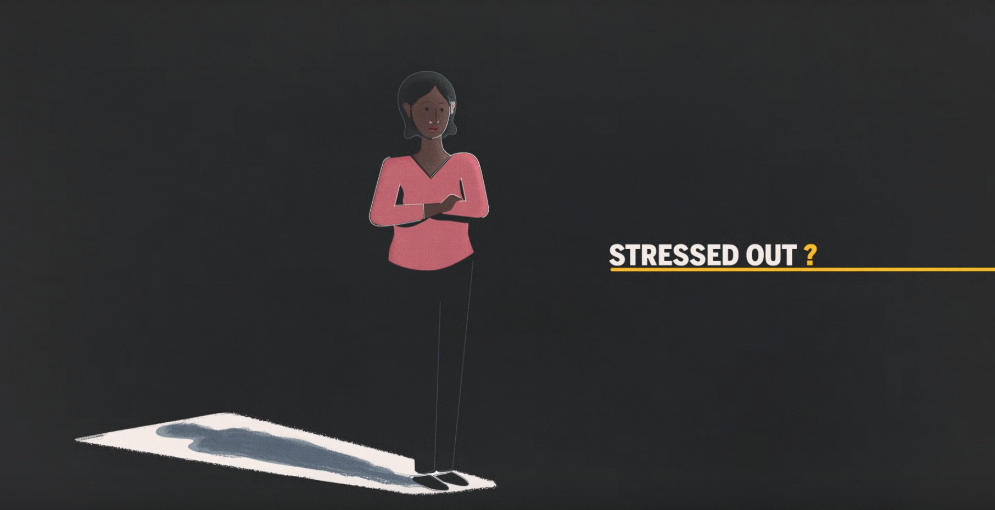
A Quick Video About Stress
How Stress Affects Your Brain (4:15)
https://www.youtube.com/watch?v=WuyPuH9ojCE
Notes:
Here is a short video with more details about the body’s stress response

Slide 8
Common Sources of Stress for College Students
Unhealthy Competition
Parental Expectation and Style
Homesickness
Social Anxiety
Financial Burden
Notes:
Unhealthy Competition: When we obsess on getting a high GPA, this can cause additional stress. We all know grades can impact your future. Failing grades only means rejection for opportunities, scholarships may be revoked, it may impact your class ranking, or even affect your graduate school acceptance. And yes, ultimately your job offers.
Parental Expectation and Style: There are parents who pressure their children to opt for their own preferences without taking into consideration their kids interest and aptitude. The burden of living up to parent’s expectation can take a toll on the students stress.
Homesickness: Ask any students who go to college; did they expect to feel homesick? Do not be surprised, it is more common than you think. Even the hardened students feel some form of sadness as they separate from their old lives. But research shows, 1 out of 10 will find it hard to adapt.
Financial Burden: Let’s face it, college isn’t exactly cheap. Year after year, it is getting more expensive whether you choose to attend a community college or a private one. Unless you’ve received a full-ride scholarship, college can be a financial burden.

Slide 9
True or False? Some Types of Stress Can Be Beneficial
True! A certain type of stress called “eustress” is necessary and beneficial for a balanced and exciting life. Eustress makes us feel vital and alive (Chronic stress is another story)
An example of eustress at work is taking on a new project that encourages you to leverage existing strengths (which can be incredibly energizing) and requires you to hone existing skills or learn new ones.
Notes:
A certain type of stress, known as ‘eustress,' is actually necessary and beneficial for a balanced and exciting life. Eustress is the type of stress you experience when you're riding a roller-coaster (if you enjoy fast rides), are playing a fun game, or are falling in love.
In terms of opposites, distress and eustress are on either end of the spectrum. Unlike eustress, distress can make you feel overwhelmed because your resources (physically, mentally, emotionally) are inadequate to meet the demands you’re facing.

Slide 10
How to Deal with Stress
Eat well
Exercise
Have an outlet
Build a Support System
Make plan
Think Positively
Notes:
Eat well: did you know that an unhealthy diet can increase your stress levels? When you eat healthy, you equip your body with the nutrition it needs to fight stress. Avoid high-fat, high-sugar foods, and go easy on the caffeine
Exercise: this is one of the best things you can do to reduce stress. Exercise produces endorphins, the feel-chemicals that act as natural painkillers, and it also improves sleep, which in turn reduces stress.
Have and outlet: You need a break most when you believe you don’t have time to take a break Find a new hobby, play sports, paint, draw – do something that gives you an outlets from the tension of every day life.
Build a support system: having a strong support system is vital to weathering stressful times and living a joyful life. Surround yourself with family or friends who lift you up, encourage you, listen without judgement, and provide sound perspective
Make a plan: get organized, make a plan, and stick to it. Prioritize your obligations each week and then schedule time for each – time for studying, working, friends, family, and yourself.

Slide 11
What is Mindfulness?
Mindfulness is a type of meditation
Focus on being intensely aware of what you’re sensing and feeling at the moment, without interpretation
Involves breathing methods, guided imagery, and other physical practices to relax the body and mind
Notes:
Whenever you bring awareness to what you’re directly experiencing via your senses, or to your state of mind via your thoughts and emotions, you’re being mindful.

Slide 12
Lavender
Lavender has historically been used to treat many different ailments, including:
Insomnia
Anxiety
Headaches
Most commonly used for aromatherapy
Believed to promote calmness and wellness
Notes:
Many people have enjoyed the pleasing fragrance of lavender and used it to treat a variety of conditions. People say its uses range from helping them calm down and get a good night’s sleep to managing sleeplessness, anxiety, and menstrual cramps. Though reports from the medical experts are mixed, lavender does have many potential benefits that you might want to try.

Slide 13
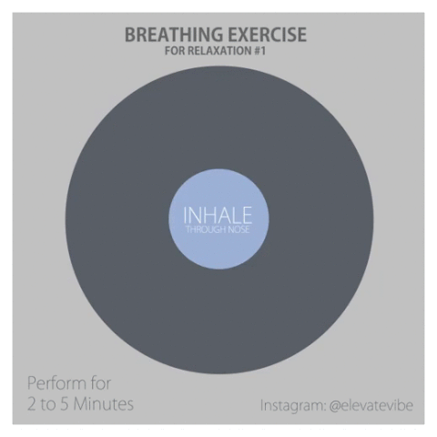
Mindfulness Activity
Mindful breathing for 2 minutes
Align your breathing with the picture
Notes:
We’re going to practice one mindfulness technique that you can try when you’re feeling stressed or just need to take a moment to collect yourself
Look at this picture and try to align your breathing with it
I’m going to turn off the lights and we’re going to practice this
Lower your eyes and notice where you feel your breath.
That might be the air going in and out at your nostrils or the rise and fall of your chest or stomach.
If you can’t feel anything, place your hand on your stomach and notice how your hand gently rises and falls with your breath.
Focus on your breath. When your mind wanders, as it will do, just bring your attention back to your breath.
You might like to say ‘thinking’ when you notice your thoughts and just gently shepherd your attention back to your breath.
(after one minute has passed)
Okay now slowly open your eyes and
This can be done for longer than two minutes. However, even for two minutes it will allow you to pause and be in the moment.

Slide 14
Campus Resources
Counseling and Psychological Services (CAPS)
Monday-Friday 8:30 AM – 5:00 PM
Room 552 Student Center Building
Free and confidential personal, couples, and group counseling is available
WSU College of Education Counseling and Testing Center
Tuesday and Thursday 2 PM – 7 PM
3rd floor education building, Room 306
Free individual and group counseling
WSU Psychology Clinic
Monday and Wednesday 9 AM – 7 PM, Tuesday and Thursday 9 AM – 8 PM,
Friday 9 AM – 5 PM
60 Farnsworth Street, Rackham Building, Detroit, MI 48202
Affordable rates available. No insurance is accepted. Cash or checks only.
Therapy for adults, couples, adolescents, children, groups, and families. Both short- and long-term treatments are available.
Notes:
CAPS is part of Student Services and is the university agency dedicated to provide counseling and psychological services for Wayne State students and to provide consultation and outreach to the university community in support of student welfare.
The WSU College of education counseling and testing center also offers free counseling, with individual and group counseling aimed to assist clients in making realistic vocational choices, to resolve problems in interpersonal functioning and eliminate self-defeating and/or abusive activities.
The WSU psychology clinic is another resource. A wide range of assessment services are offered for children, adolescents and adults, including intellectual, neuropsychological, personality, and the assessment of learning disabilities.

