Slide 1
Smoking Cessation
Campus Health Center

Slide 2
Ways to Quit Smoking
Going cold turkey
Around 90% try quitting without any aid, therapy, or medicine
Medications
Nicotine replacement products
Counseling
Working with a counselor to find ways not to smoke and figure out the triggers that could lead to smoking again

Slide 3
Nicotine Replacement Therapy
Most commonly used way to reduce withdrawal feelings by giving small amounts of nicotine to slowly reduce the urge to smoke
Types of nicotine replacement therapy include:
Nicotine Patch
Nicotine Gum
Nicotine Lozenge
Inhaler
Nasal spray

Slide 4
Nicotine Patch
Also known as transdermal patch are applied to the skin and steadily deliver small amounts of nicotine
Available in different doses delivering between 5mg and 22mg of nicotine over 24-hour period
No need for a prescription

Slide 5
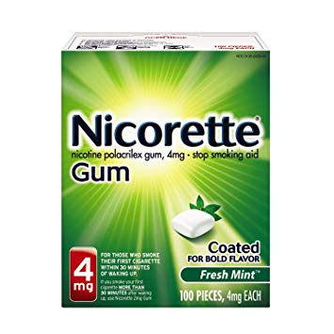
Nicotine Gum
First nicotine replacement therapy to be introduced
Chewed intermittently until you get a tingling feeling then its held in the mouth
Available in 2mg and 4mg dosages
No need for a prescription, over the counter

Slide 6
Nicotine Lozenge
Over the counter
Available in 2mg and 4mg formulations
Releases nicotine as it slowly dissolves in the mouth
Nicotine is absorbed through the buccal mucosa and delivered into systemic circulation

Slide 7
Inhaler
Need a prescription
Nicotine is delivered by inhaling it through a mouthpiece that’s attached to a plastic cartridge
Contains about 10mg of nicotine

Slide 8
Nasal Spray
Need a prescription
A multi-dose bottle containing nicotine with a pump mechanism
Delivers 0.5 mg of nicotine with one squirt to each nostril

Slide 9
The 5 A’s to Intervention
Ask – identify and document that status of the patient by asking them about their tobacco usage
Advise – suggest and urge the user to quit
Assess – check if the user is willing to quit
Assist – help the patient quit by using counseling or pharmacotherapy
Arrange – do follow-ups with the patient, either in person or by telephone, within the first week

Slide 10
Health Benefits of Quitting
Over time:
20 minutes – heart rate returns to normal levels
12 to 24 hours – reduced risk of a heart attack & carbon monoxide levels drop
2 weeks to 3 months – lung functions start to improve
1 to 9 months – a decrease in coughing and shortness of breath
1 year – risk of coronary heart disease is half that of a smoker’s
5 to 15 years – risk of having a stroke is reduced; dying from lung cancer or getting cancer of the mouth, throat, or esophagus is half that of a smoker’s

Slide 11
Need help quitting?
Michigan Tobacco Quitline 1-800-QUIT-NOW
Free service from Michigan Department of Health and Human Services
Special services for pregnant women, non-English speaking individuals, Deaf or hard-of-hearing individuals, American Indian individuals
Under 18? Call or text “start my quit” to 1-855-891-9989
For more information visit https://michigan.quitlogix.org/en-US/

Slide 12
References
Benefits of Quitting Smoking. (2019, August 7). Retrieved December 9, 2019, from https://www.lung.org/stop-smoking/i-want-to-quit/benefits-of-quitting.html.
Using Nicotine Replacement Therapy: Smokefree. (n.d.). Retrieved December 10, 2019, from https://smokefree.gov/tools-tips/how-to-quit/using-nicotine-replacement-therapy.
Wadgave, U., & Nagesh, L. (2016). Nicotine Replacement Therapy: An Overview. International journal of health sciences, 10(3), 425–435.
Five Major Steps to Intervention (The "5 A's"). (n.d.). Retrieved December 27, 2019, from https://www.ahrq.gov/prevention/guidelines/tobacco/5steps.html.

