Slide 1
Why Your New Year’s Resolution Should Be Getting Enough Sleep
Presented by Evan Gurney
WSU MD/MPH Candidate
Supervised and Reviewed by:
Karen Huyghe, MA Marketing and Public Relations Manager
Erika Blaskay, RN Community Outreach Nurse

Slide 2
What are we going to cover
today?
About sleep
How much sleep you need
Sleep deprivation
What to do if you can’t sleep
Sleep hygiene
Sleep disorders

Slide 3
Introduction to sleep
(1,2,3)
Scientists are still unsure of the exact reason why people need sleep
But getting enough sleep is essential for survival, like food or water
Sleep is complex and impacts all parts of the body
We spend about 1/3 of our day sleeping
Many chemicals and hormones in the body regulate sleep
The brain and body remain pretty active during sleep
Sleep allows our brain and body to perform housekeeping
Like removing toxins and healing

Slide 4
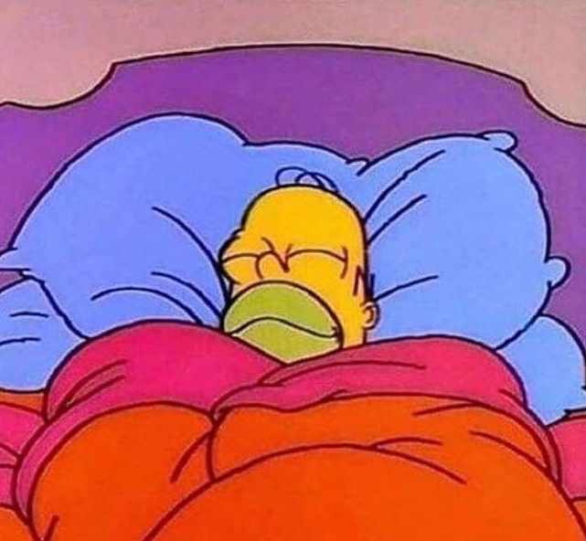
More about sleep
(1,2,3)
Certain brain chemicals promote sleep and become active when we get ready for bed
GABA, norepinephrine, serotonin, and adenosine
Within a few minutes of falling asleep there are changes in the body and brain
Lower body temperature, decreased brain activity, heart rate and breathing slow
Over the night we go through multiple sleep cycles that last 70-120 minutes and each cycle has 4 main stages

Slide 5
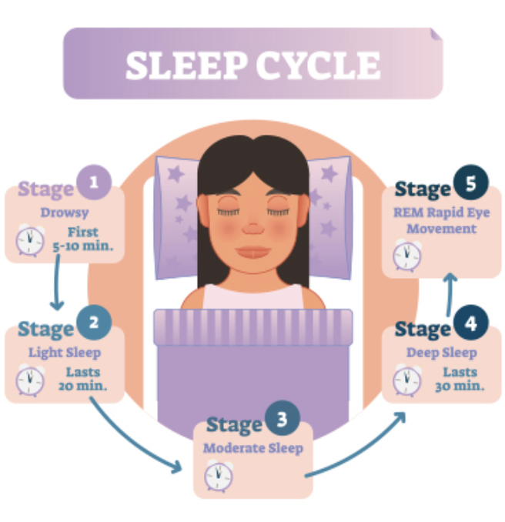
The sleep cycle
(4)
Sleep cycle and stages vary by person, age, and alcohol consumption
NonREM sleep
Stage 1 – dozing off
1-5 minutes
Stage 2 – drop in temperature, relaxed muscles, and slowed breathing and heart rate
10-25 minutes, becomes longer throughout the night
Stage 3 and 4 – deep sleep – body is very relaxed, restorative sleep
20-40 minutes, shorter as night goes on
REM sleep
Active brain, dreaming, atonia
Few minutes, an hour by the end of the night

Slide 6
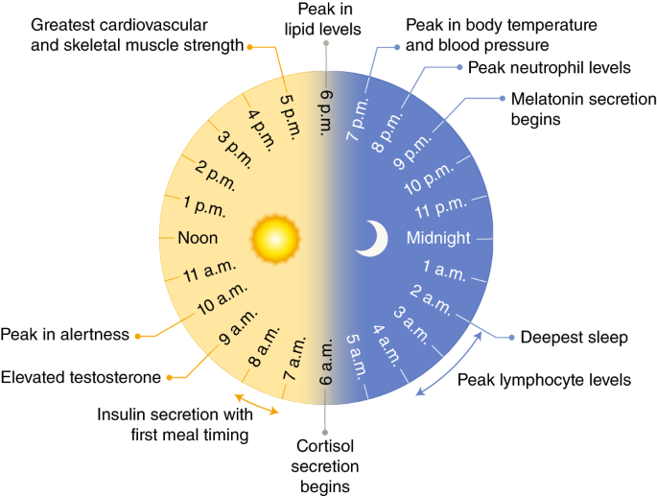
The circadian rhythm
(5)
Our body’s internal, 24 hour clock
Sleep-wake cycle
Based on light/dark, day/night
Light = alertness
Dark = releases melatonin to prepare for sleep
If thrown off, the body doesn’t function as well
Notes:
Image: https://www.nature.com/articles/s41591-018-0271-8

Slide 7
Melatonin
(6)
A hormone the brain produces in response to darkness
Pineal gland
Helps regulate the body’s circadian rhythm
Promotes transition to sleep
Supplemental melatonin
Usually synthetic
Research shows benefit for jet lag and delayed sleep wake phase disorder
There’s not strong evidence that it helps with insomnia
Short-term use is safe for most people
It may interact with other medications or supplements
Side effects:
Headache, dizziness, nausea, sleepiness
Potential long-term side effects are not clear

Slide 8
Naps
(7)
1/3 of adults nap
Different types of naps based on their purpose
Recovery nap = catching up for not getting enough sleep the night before
Appetitive nap = for enjoyment and relaxation
Essential nap = when you’re sick and your body needs more sleep than normal
The ideal nap = a power nap
10-20 minutes
Provide recovery benefits without leaving you sleepy afterwards
To take the best nap:
Set an alarm, nap early in the day, create a sleep friendly environment, and relax
Remember, napping can interfere with your ability to fall asleep at night

Slide 9
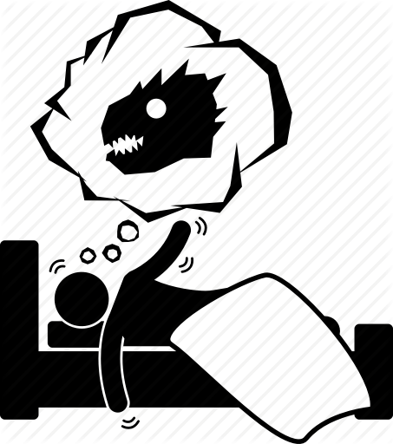
Dreams
(8)
A sequence of sensations, emotions, ideas, and images that occur during certain stages of sleep
Most vivid dreams occur during REM sleep
With the exception of lucid dreaming, you can’t control your dreams
Can last from a few seconds to 20-30 minutes
3-5 dreams per night
People remember their dreams when they wake up right after REM before falling back asleep
While the true purpose of dreams is still unknown, there are many theories
May help with memory formation, problem solving, and processing of emotions
Housekeeping
May be random brain activation

Slide 10
Why is getting enough sleep important?
(9)
Sleep is important for physical, mental, and emotional health, as well as quality of life
Quality sleep improves our ability to learn, remember, and pay attention
Form new pathways during sleep
Improved academic performance
Without enough sleep:
Slower reaction times
Difficulty problem solving
Making more mistakes

Slide 11
Are you getting enough sleep?
(10,11)
Most adults need 7-9 hours of sleep a night
35% of adults don’t get the recommended amount of sleep

Slide 12
Sleep deprivation in college
(12,13)
Only 11% of college student sleep well consistently
40% feel well rested no more than two days a week
College students who pull “all nighters” are more likely to have a lower GPA

Slide 13
Symptoms of sleep deprivation
(14,15)
Not feeling alert or refreshed when you wake up
Feeling tired during the day
Falling asleep while reading or watching tv
Not being able to concentrate
Slowed thinking
Memory problems
Mood changes

Slide 14
Health effects of sleep deprivation
(14,15)
Increased risk of accidents or injuries
Car accidents
Heart disease
High blood pressure
Difficulty maintaining a healthy weight
Feel hungrier
Diabetes
Worsens immune system function
Body has more difficulty fighting off infections
Also associated with mental health disorders
Increased risk of depression and suicide

Slide 15
Overview of sleep disorders: Insomnia, Narcolepsy, Restless Leg Syndrome, Sleep Apnea
(13)
Students with symptoms of sleep disorders are more likely to receive poor grades than peers without symptoms of sleep disorders

Slide 16
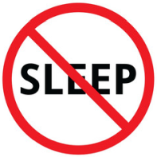
Insomnia
(16,17,18)
Trouble falling or staying asleep
Lie awake for a long time before falling asleep
Only sleep for short amounts of time
Wake up early
Studies show 30% of adults suffer from insomnia, while in 10% it is severe enough to cause daytime consequences
Short term – from stress, changes in schedule
Chronic (long term) – lasts more than 3 months
9.5% of college students meet this criteria
Diagnosed by your doctor
Sleep diary
Rule out other cause like medication or health problem
Treatment is a combination of sleep hygiene, therapy, and medication

Slide 17
Narcolepsy
(19)
Lifelong neurological disorder where the brain can’t regulate sleep-wake cycles
Symptoms:
Excessive daytime sleepiness – sleep attacks
No matter how much sleep they get
Cataplexy = weakness from sudden loss of muscle tone
Triggered by strong emotions
Sleep paralysis
When falling asleep or waking up, temporarily unable to move or speak
Hallucinations
Disturbed sleep and insomnia
Diagnosed by a sleep study
Treatment involves lifestyle changes and medication

Slide 18
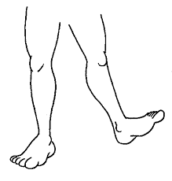
Restless leg syndrome
(20)
Uncomfortable or unpleasant feelings in the legs that results in an irresistible urge to move them
Aching, throbbing, pulling, itching, crawling, or creeping feeling
Can occur in the afternoon or evening, but is most common at night when a person is resting or laying down
Symptom free in the morning making it easier to sleep at that time
Can make it difficult to fall or stay asleep
Treatment involves ruling out a medical cause, lifestyle changes, and medication

Slide 19
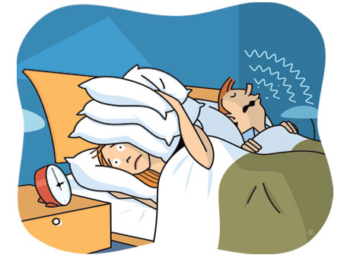
Sleep Apnea
(21)
Abnormal breathing during sleep
Pauses in breathing that lead to poor quality sleep and decreased oxygen
2-9% of adults, but many go undiagnosed
Symptoms:
Snoring, gasping, or snorting during sleep, excessive daytime sleepiness, morning headaches, irritability
Risk factors include large neck, tongue, uvula, or tonsils, smoking, and obesity
Leads to a lot of health problems
Diagnosed by sleep study
Treatment can involve weight loss, special mouth pieces, or CPAP, a machine that pushes air into the airway at night
Notes:
https://www.sleepfoundation.org/sleep-apnea

Slide 20
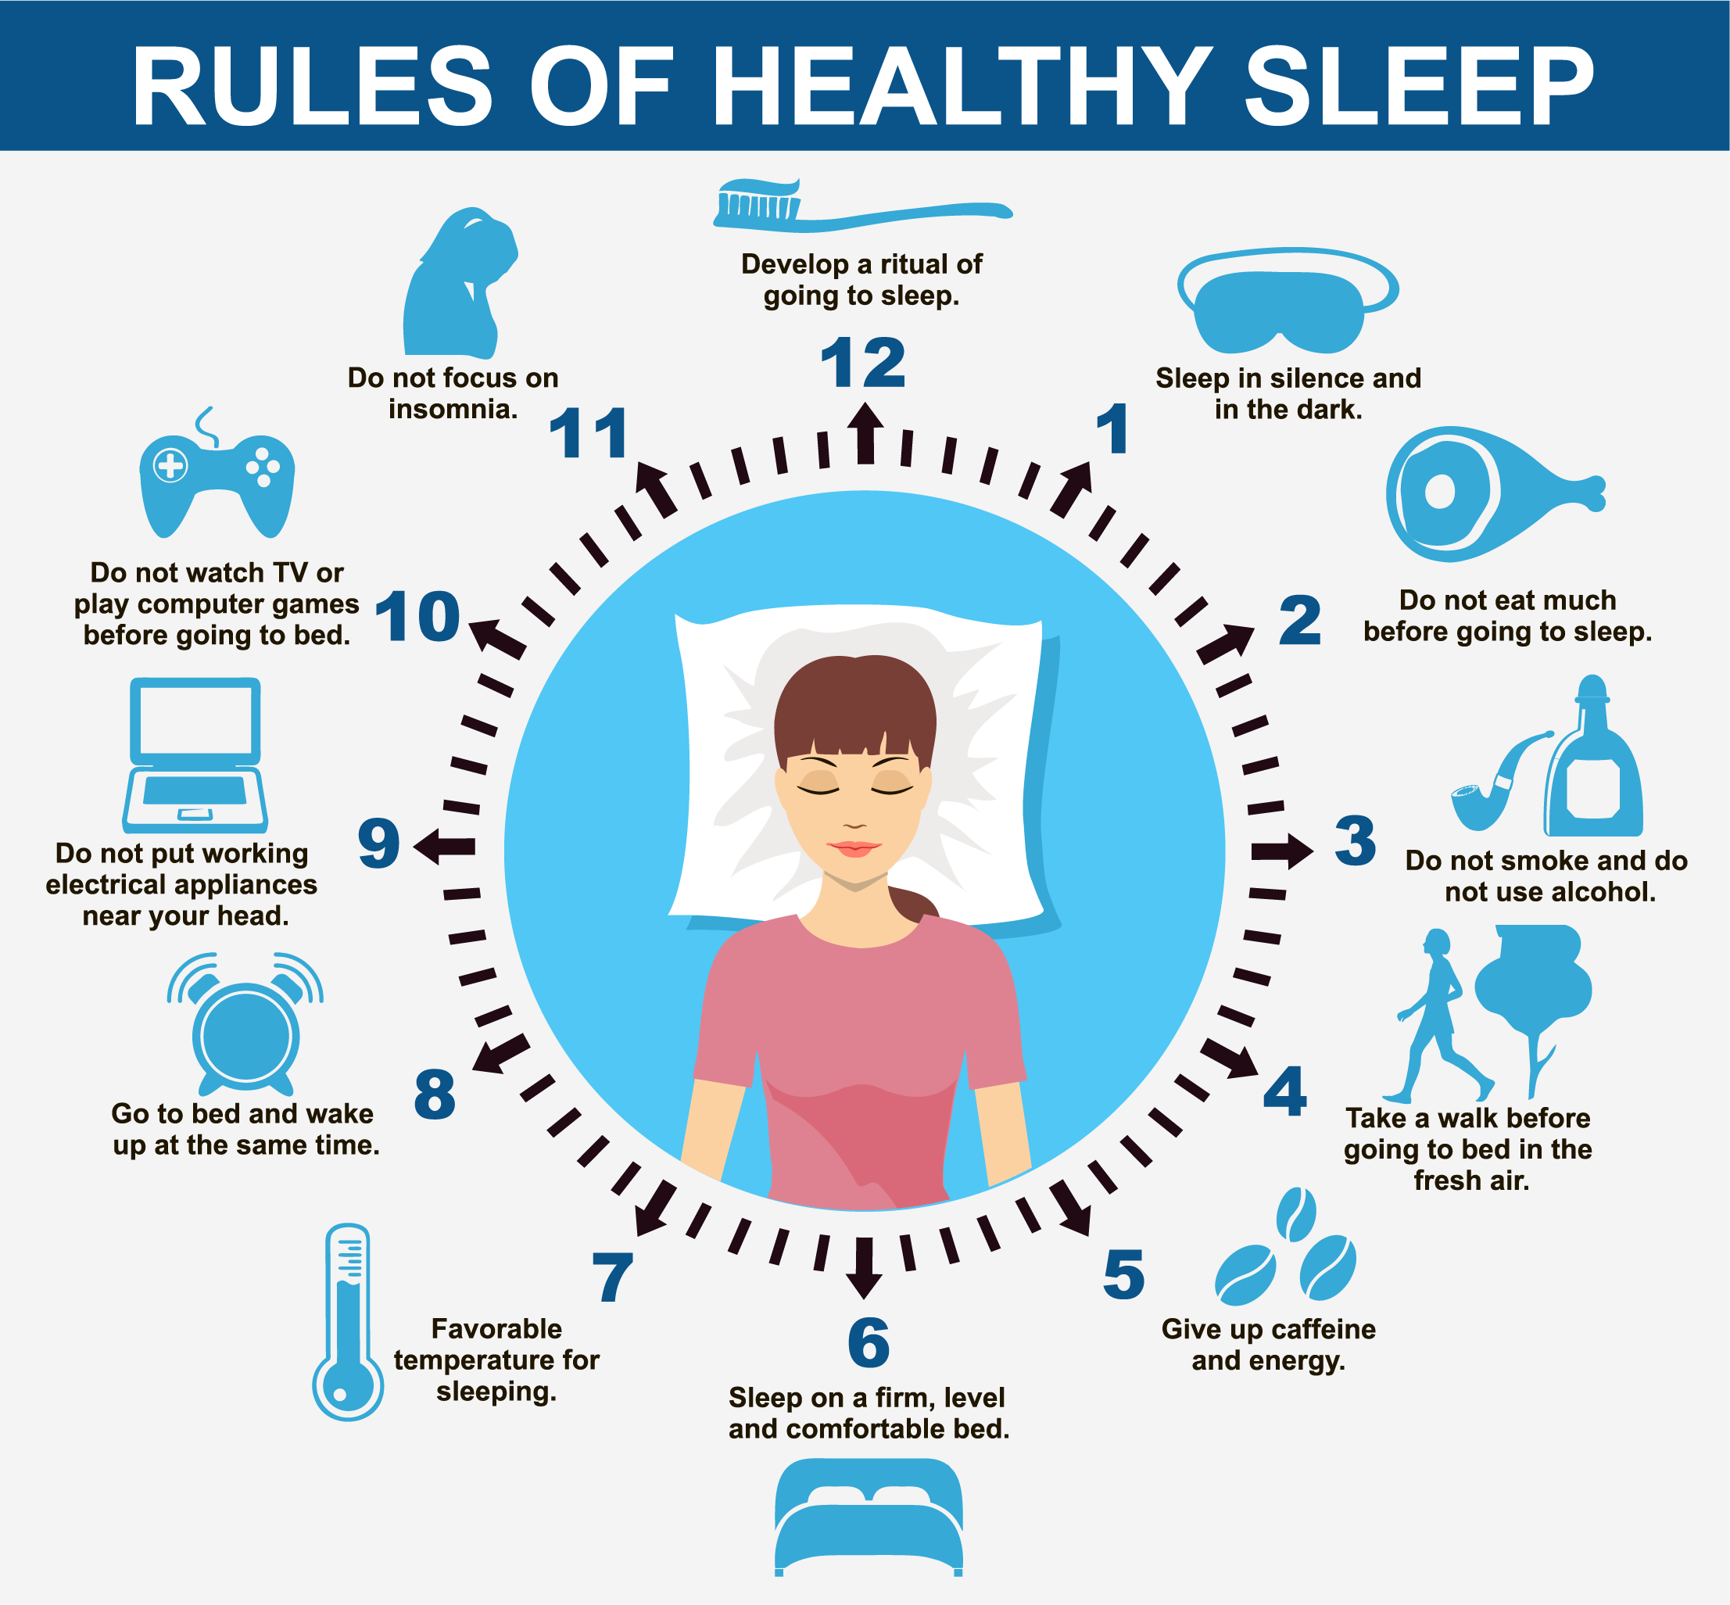
Sleep hygiene
(22)
Sleep hygiene = good sleep habits
One of the easiest ways to set yourself up for better sleep
Create bedroom environment and daily routines that promote consistent, uninterrupted sleep
Different tips that can be tailored to you and adjusted as you discover what works and improves your sleep
Create your own sleep hygiene checklist

Slide 21
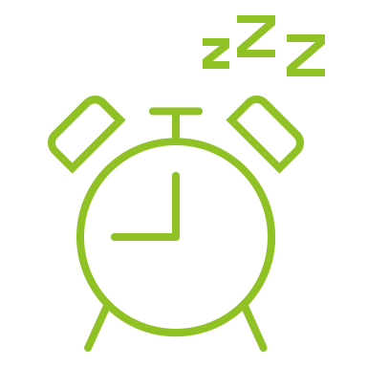
Tips for improving sleep
(22)
Set a sleep schedule
Prioritize your sleep and schedule time for you to get enough sleep
Don’t make large adjustments at one time, stick to 1-2 hours
Don’t overdo it with naps
Short naps in the early afternoon to avoid throwing off your sleep schedule
Create a nightly routine
Be consistent! Follow the same steps every night
Give yourself 30 minutes to wind down, do a quiet activity like reading, listening to soft music, or relaxation exercises
Try to stay away from bright lights and electronics
Reduce melatonin production
Try relaxation techniques
If you haven’t fallen asleep in 20 minutes, get up and do a quiet, relaxing activity before you try again

Slide 22
More tips for better sleep
(22)
Make healthy daily habits
Get sunlight exposure – helps your circadian rhythm
Physical activity
Don’t smoke – nicotine disrupts sleep
Reduce alcohol, especially near bedtime
Avoid caffeine later in the day
Don’t eat dinner or a large meal right before bed
Optimize your bedroom
Bedroom temperature – usually cooler temperatures (65F) are better for sleep
Darkness – use blackout curtains or an eye mask to eliminate light
Reduce bothersome noise – use earplugs, white noise, or a fan
Calming scents – lavender

Slide 23
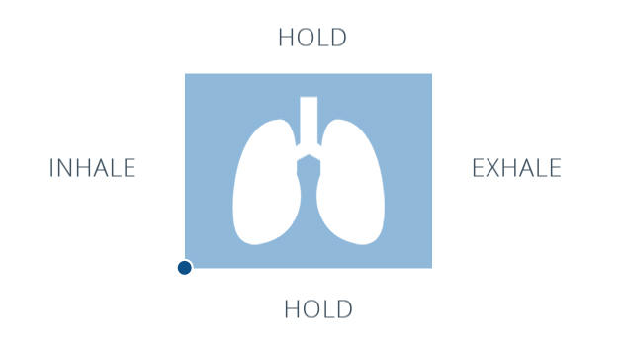
Mindfulness Meditation
(23)
Studies show even a small amount can improve sleep
Mindful breathing exercise
Body scan
Free apps
Insight Timer
Headspace
Smiling Mind
Calm
Stop, Breathe, Think
10% Happier
Campus Health Center Mindfulness Techniques health program

Slide 24
What to do if you still can’t sleep
(24)
If you’ve tried improving your sleep with sleep hygiene and are still struggling with sleep to where it’s impacting your daily functioning, you may need to talk to your doctor
But first create a sleep diary
Include when you
Go to bed
Go to sleep
Wake up
Get out of bed
Take naps
Exercise
Drink alcohol
Drink caffeinated beverages
Take medication or supplements
You may notice patterns you haven’t before that are detrimental to your sleep hygiene
A sleep diary provides your doctor with important information that can help them determine the next steps

Slide 25
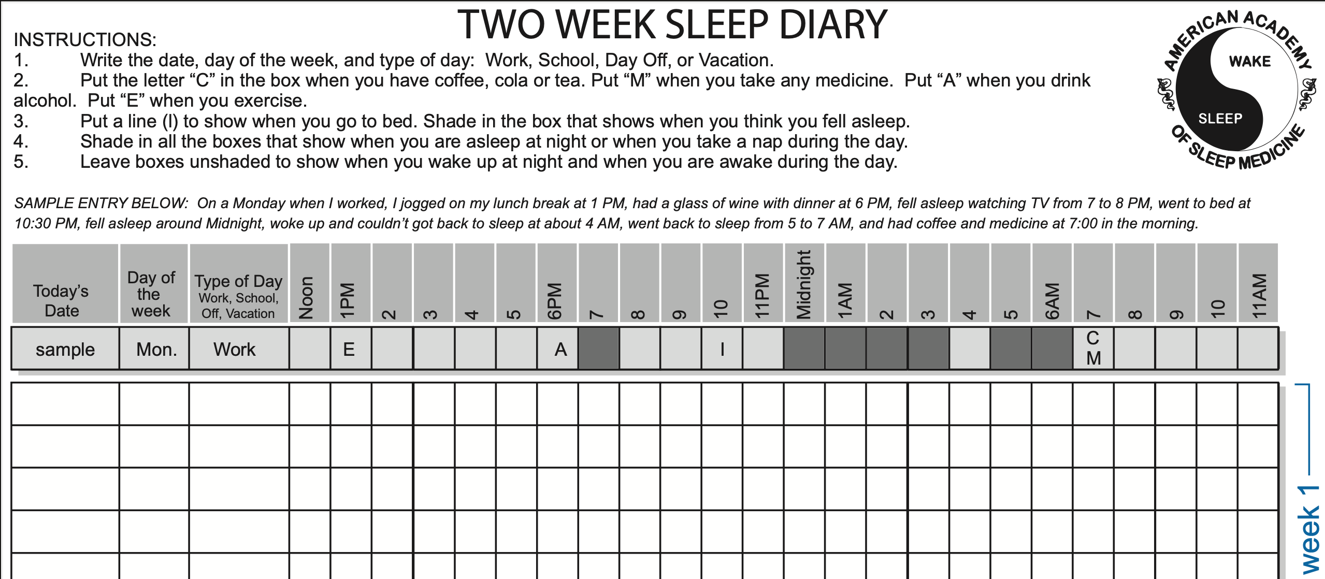

Slide 26
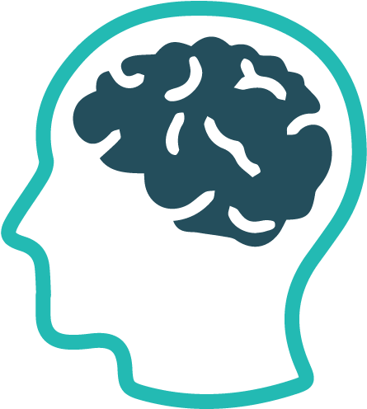
Mental Health and Sleep
(25,26)
Several mental health disorders can cause sleep issues and symptoms that look like sleep deprivation
Anxiety
Easily fatigued, trouble concentrating
Difficulty falling or staying asleep, restlessness, or not feeling well rested
Depression
Low energy, fatigued, problems with concentration or memory
Difficulty falling asleep, early morning awakening, or oversleeping
Wayne State University Counseling and Psychological Services (CAPS)
Free and confidential for students
552 Student Center Building, Detroit, MI 48202 | 313-577-3398 | Crisis/information line (nights/weekends/university closures): 313-577-9982

Slide 27
Contact Us
Campus Health Center
5285 Anthony Wayne Drive
Detroit, MI 48202
(313) 577-5041
Email at CampusHealth@wayne.edu
Online at health.wayne.edu
Follow us on social media:
Twitter - @WSUCampusHealth
Facebook - @CampusHealthCenter
Instagram - @campushealthcenter
Now offering telehealth visits through telephone or webcam!
Notes:
Thank audience for listening to presentation. Offer contact information.

Slide 28
References
Brain Basics: Understanding Sleep | National Institute of Neurological Disorders and Stroke. (2019, August 13). National Institute of Neurological Disorders and Stroke. https://www.ninds.nih.gov/Disorders/patient-caregiver-education/understanding-sleep
ASA Authors & ReviewersSleep Physician at American Sleep Association Reviewers and WritersBoard-certified sleep M.D. physicians, scientists, editors and writers for ASA. (2020, January 30). What is Sleep and Why is It Important? American Sleep Association. https://www.sleepassociation.org/about-sleep/what-is-sleep/
Suni, E. (2020a, November 20). How Sleep Works: Understanding the Science of Sleep. Sleep Foundation. https://www.sleepfoundation.org/how-sleep-works
Suni, E. (2020a, October 28). Stages of Sleep. Sleep Foundation. https://www.sleepfoundation.org/articles/stages-of-sleep
What is Circadian Rhythm? (2020, November 25). Sleep Foundation. https://www.sleepfoundation.org/circadian-rhythm
Melatonin: What You Need To Know. (2019, October). NCCIH. https://www.nccih.nih.gov/health/melatonin-what-you-need-to-know
Fry, A. (2020, November 21). Napping: Health Benefits & Tips for Your Best Nap. Sleep Foundation. https://www.sleepfoundation.org/articles/napping
Dreams: What They Mean & Psychology Behind Them. (2020, March 12). American Sleep Association. https://www.sleepassociation.org/about-sleep/dreams/
Sleep Deprivation and Deficiency | NHLBI, NIH. (2020, April 28). National Heart, Lung, and Blood Institute. https://www.nhlbi.nih.gov/health-topics/sleep-deprivation-and-deficiency
CDC - How Much Sleep Do I Need? - Sleep and Sleep Disorders. (2017, March 7). Centers for Disease Control and Prevention. https://www.cdc.gov/sleep/about_sleep/how_much_sleep.html
CDC Press Releases. (2016, January 1). Centers for Disease Control and Prevention. https://www.cdc.gov/media/releases/2016/p0215-enough-sleep.html
National College Health Assessment. (2007). American College Health Association. https://www.acha.org/documents/ncha/ACHA-NCHA_Reference_Group_ExecutiveSummary_Fall2007.pdf
College students: getting enough sleep is vital to academic success. (2020, January 27). American Academy of Sleep Medicine – Association for Sleep Clinicians and Researchers. https://aasm.org/college-students-getting-enough-sleep-is-vital-to-academic-success/

Slide 29
References continued
Sleep Deprivation and Deficiency | NHLBI, NIH. (2020, April 28). National Heart, Lung, and Blood Institute. https://www.nhlbi.nih.gov/health-topics/sleep-deprivation-and-deficiency
Sleep Deprivation: Causes, Symptoms, & Treatment. (2020, November 20). Sleep Foundation. https://www.sleepfoundation.org/sleep-deprivation
American Academy of Sleep Medicine. (2008). Insomnia. https://aasm.org/resources/factsheets/insomnia.pdf
Taylor, D. J., Bramoweth, A. D., Grieser, E. A., Tatum, J. I., & Roane, B. M. (2013). Epidemiology of insomnia in college students: relationship with mental health, quality of life, and substance use difficulties. Behavior therapy, 44(3), 339–348. https://pubmed.ncbi.nlm.nih.gov/23768662/
Insomnia | NHLBI, NIH. (2020, March 2). National Heart, Lung, and Blood Institute. https://www.nhlbi.nih.gov/health-topics/insomnia
Narcolepsy Fact Sheet | National Institute of Neurological Disorders and Stroke. (2020). National Institute of Neurological Disorders and Stroke. https://www.ninds.nih.gov/Disorders/Patient-Caregiver-Education/Fact-Sheets/Narcolepsy-Fact-Sheet
Restless Legs Syndrome Fact Sheet | National Institute of Neurological Disorders and Stroke. (2020, March 17). National Institute of Neurological Disorders and Stroke. https://www.ninds.nih.gov/Disorders/Patient-Caregiver-Education/Fact-Sheets/Restless-Legs-Syndrome-Fact-Sheet
Suni, E. (2020, December 2). Sleep Apnea - Causes & Symptoms. Sleep Foundation. https://www.sleepfoundation.org/sleep-apnea
Suni, E. (2020, November 21). What is Sleep Hygiene? Sleep Foundation. https://www.sleepfoundation.org/articles/sleep-hygiene
Hülsheger, U. R., Feinholdt, A., & Nübold, A. (2015). A low-dose mindfulness intervention and recovery from work: Effects on psychological detachment, sleep quality, and sleep duration. Journal of Occupational and Organizational Psychology, 88(3), 464–489. https://doi.org/10.1111/joop.12115
CDC - What Should I Do If I Can’t Sleep? - Sleep and Sleep Disorders. (2017, March 9). Centers for Disease Control and Prevention. https://www.cdc.gov/sleep/about_sleep/cant_sleep.html
NIMH » Anxiety Disorders. (2018, July). National Institute of Mental Health. https://www.nimh.nih.gov/health/topics/anxiety-disorders/index.shtml
NIMH » Depression. (2018, February). National Institute of Mental Health. https://www.nimh.nih.gov/health/topics/depression/index.shtml
Sleep diary: http://yoursleep.aasmnet.org/pdf/sleepdiary.pdf

