Slide 1
Safe Sex & Contraception
Protection from STIs and Prevention of Pregnancy

Slide 2
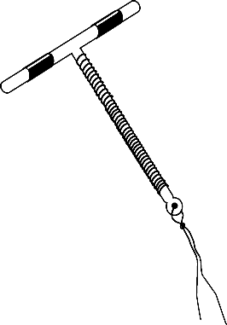
What are Intrauterine Devices? (IUDs)
Small, “T-shaped” device inserted into the uterus to prevent pregnancy
Safe, effective, and long lasting
Must be inserted by a health care provider
Notes:
Insurance may cover at no cost

Slide 3
How do IUDs work?
IUDs affect the way sperm move, preventing them from joining with an egg
IUDs are one of the most effective forms of birth control available
Less than 1 out of 100 people using an IUD will get pregnant each year while using an IUD.
How effective are IUDs?

Slide 4
IUD
Advantages
Effective for 12 years (Copper), 5 years (Mirena), or 3 years (Skyla, Liletta)
Use Mirena for heavy bleeding and cramps
Ability to become pregnant returns quickly after removal of IUD
Possible Disadvantages
Mild/ moderate pain during insertion
Spotting or irregular periods (Progestin)
Increase in cramps & bleeding (Copper)
Rarely, insertion can cause puncture of wall of uterus.

Slide 5
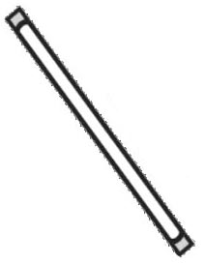
What are Implants?
A matchstick-sized rod that is inserted in the arm to prevent pregnancy
Safe, effective, and convenient
Must be inserted by a health care provider
Notes:
Insurance may cover at no cost. May soon be FDA-approved for 5 years.

Slide 6
How do Implants work?
The birth control implant releases a hormone called progestin which prevents ovaries from releasing eggs (ovulation)
Pregnancy cannot happen if there is no egg present to join with sperm
How effective are Implants?
The birth control implant is very effective. Less than 1 out of 100 people using an implant a year will become pregnant using the implant lasting up to 3 years.

Slide 7
Implant
Advantages
3 years of protection against pregnancy
No pill to take daily
Ability to become pregnant returns quickly when implant is removed
Disadvantages
Irregular, unpredictable bleeding pattern
Occasional bleeding can be more than desirable
Soreness, bruising or swelling for a few days at insertion site

Slide 8
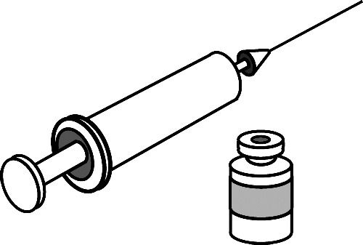
What is the Depo Shot?
A shot injected into the arm that prevents pregnancy
Safe, effective, and convenient
Easy to get with a prescription from a health care provider
Effective for 3 months

Slide 9
How does the shot work?
The birth control shot releases a progestin, which prevents ovaries from releasing eggs (ovulation does not occur)
How effective is the shot?
The birth control shot is very effective at preventing pregnancy. Less than 6/100 people taking depo will get pregnant each year if they always use the birth control shot as directed.

Slide 10
The Shot (Depo)
Advantages
Effective for 12 weeks
No pill to take daily
Improves cramping during painful menstruation
Disadvantages
Irregular, unpredictable bleeding
Possible weight gain: 4lbs per year
Possible delay in return to fertility
Possible temporary bone thinning
Possible hair thinning

Slide 11
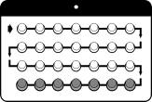
What are Birth Control Pills?
Take one pill each day at the same time of day to prevent pregnancy
Safe, effective, and convenient
Easy to get with a prescription from a health care provider

Slide 12
How do birth control pills work?
Birth control pills are made of hormones- either estrogen, progestin, or both. The hormones prevent ovaries from releasing eggs (ovulation does not occur)
How effective are birth control pills?
Birth controls are very effective if taken correctly. Less than 1/100 people taking birth control pills will get pregnant each year if they always take the pill each day as directed.
About 9/100 people taking birth control pills get pregnant each year if they do not always take the pill as directed.
Notes:
Perfect use vs. typical use for shot, pill, patch, ring. Can be up to 99% effective if used PERFECTLY… but who can be perfect all the time? This is where typical use comes in.

Slide 13
Birth Control Pills (BCP)
Advantages
Can be used to change timing/frequency of period
Can improve acne
Relatively inexpensive
Can improve painful, heavy periods
Reduced risk of ovarian, uterine cancers
Quick return to fertility after stopping pills
Possible Disadvantages
Must be taken daily
Estrogen-related side effects when starting:
Breast tenderness (up to 2 weeks)
Nausea/ vomiting (up to 3 days)
Rare but serious risk for blood clot
Smokers, 35+, obese
Notes:
Benefits and side effects are estrogen-related

Slide 14
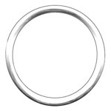
What are Vaginal Rings?
About actual size
A small ring you put in your vagina once a month for three weeks to prevent pregnancy
Safe, effective, and convenient
Easy to get with a prescription from a health care provider

Slide 15
How do Vaginal Rings work?
The vaginal ring releases the hormones estrogen and progestin, preventing ovaries from releasing eggs (ovulation does not occur)
How effective are vaginal rings?
About 9/100 people using the vaginal ring will get pregnant each year with typical use of the ring.

Slide 16
Vaginal Ring (NuvaRing)
Advantages
Many same as BCP
No pill to take daily
3 weeks IN, 1 week OUT
Disadvantages
Increased vaginal discharge present but no infection
Estrogen-related side effects and contraindications (same as the pill)
Ring may be pulled out during vaginal penetration, but effectiveness shouldn’t be affected if immediately put back in

Slide 17
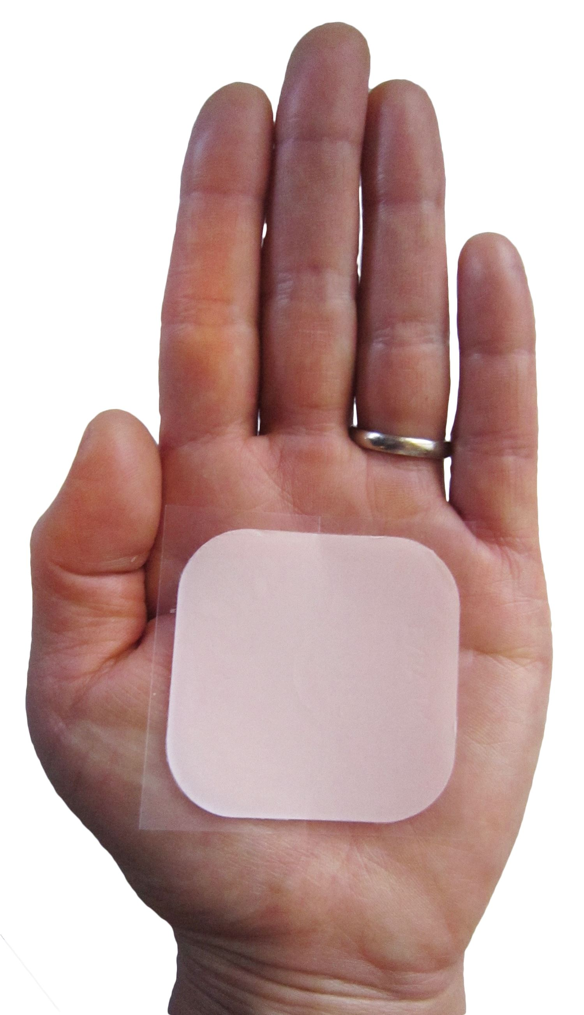
What is the Patch?
A thin piece of plastic worn on the skin by person who can become pregnant. Apply once a week for three weeks on the butt, stomach, upper arm, or torso, then leave off for 4th week.
Safe, effective, and convenient
Easy to get with a prescription from a health care provider

Slide 18
How does the patch work?
The patch releases estrogen and progestin hormones through the skin, preventing ovaries from releasing eggs and thickening cervical mucous
How effective is the patch?
The patch is very effective. It works best when a new patch is applied the same day and time each week. About 9/100 people using the patch get pregnant each year with typical use of the patch

Slide 19
The Patch
Advantages
Disadvantages
High rate of effectiveness
Regulation of menstrual cycle
Shorter, lighter periods
Less cramping
Only apply once per week
Skin irritation
Estrogen-related side effects and contraindications (same as the pill)

Slide 20
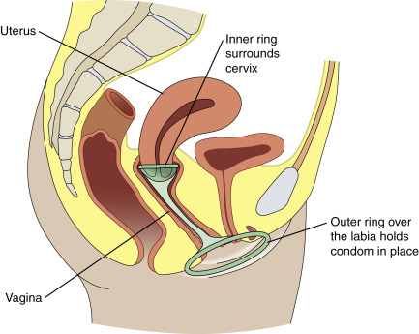
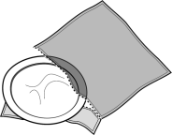
What are Condoms?
***The ONLY contraceptive method that protects against sexually transmitted infections!
One type is worn on the penis (“external” condom), another type is inserted in vagina (“internal” condom)
Made of latex or plastic
Prevent pregnancy and sexually transmitted infections
Can be used with another form of birth control for extra protection
Can be used for vaginal, anal, or oral sex
Safe effective, and easy to get/purchase
$5/50 condoms available through CONDOM CLUB @ CHC
Notes:
Can be used with another form of BC for extra protection
CONDOM CLUB= explain here!!!!!!!!!

Slide 21
How do external condoms work?
Condoms prevent pregnancy by collecting pre-cum and semen from a penis when it ejaculates, preventing sperm from entering the vagina. By covering the penis and keeping semen of out the vagina, anus, or mouth, condoms reduce risk of sexually transmitted infections
How effective are external condoms?
Each year: 2/100 people who can become pregnant whose partners use condoms can become pregnant if they always use correctly.
18/100 people who can become pregnant whose partners use condoms can become pregnant if they don’t always use correctly.

Slide 22
What is an internal condom?
A pouch inserted into the vagina to prevent pregnancy
Reduces the risk of sexually transmitted infection
Can be used for vaginal and anal intercourse
Safe and effective
$5/50 available through CONDOM CLUB @ CHC

Slide 23
How do internal condoms work?
Internal condoms cover the inside of the vagina, collecting pre-cum and semen when a penis ejaculates inside the vagina. By covering the inside of the vagina or anus and keeping semen and pre-cum out, condoms reduce the risk of sexually transmitted infections.
How effective are internal condoms?
If people who can become pregnant always use condoms correctly, 5/100 will become pregnant each year. If not always used correctly, 21/100 will become pregnant each year.

Slide 24
What is a Dental Dam?
Latex or polyurethane barrier preventing STI transmission between oral-genital or oral-anal sex
About 70% of cancers in the back of the throat are linked to HPV, a common vaccine-preventable STI
Can be purchased in stores and online, or created from a male condom
Available as an option from CHC’s Condom Club

Slide 25
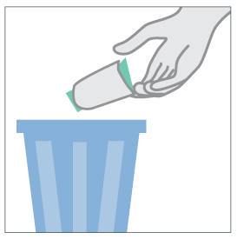
How Do Dental Dams Work?
Carefully open dental dam and remove from package.
Place dental dam flat to cover vaginal opening or anus.
Throw away used dental dam in trash. DO NOT use more than once.

Slide 26
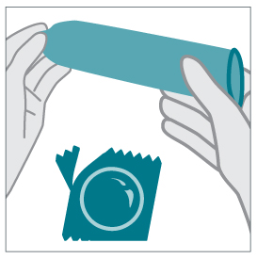
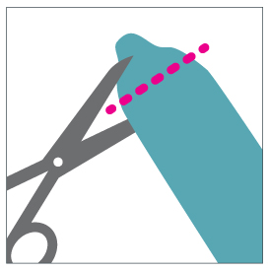
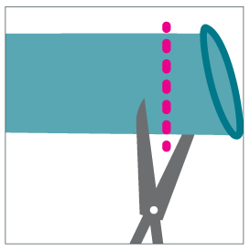
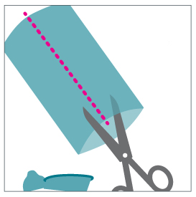
Making a Dental Dam Out of an External Condom (use latex or polyurethane condoms ONLY)
Carefully open package, remove condom, and unroll.
Cut off tip of condom.
Cut off bottom of condom.
Cut down one side of condom.
Lay flat to cover vaginal opening or anus.

Slide 27
HPV Vaccine: Another Layer of Protection
Nearly all cervical cancer is caused by Human Papillomavirus (HPV), a common sexually-transmitted virus
Certain strains can cause throat, anal, and genital cancers, as well as genital warts
HPV vaccine provides protection against the 9 strains of HPV that can cause cancer and genital warts in men and women
Safe and effective
Available at CHC, or covered by most insurances

Slide 28
What is the Pull-Out Method? (Withdrawal)
Also called “coitus interruptus”
The penis is removed out of the vagina before ejaculation occurs
Pros: No monetary cost associated
Cons:
Requires high level of self-control
Pre-cum may contain sperm: not as effective as other methods of birth control
Effectiveness: 22/100 women using this method will become pregnant each year.

Slide 29
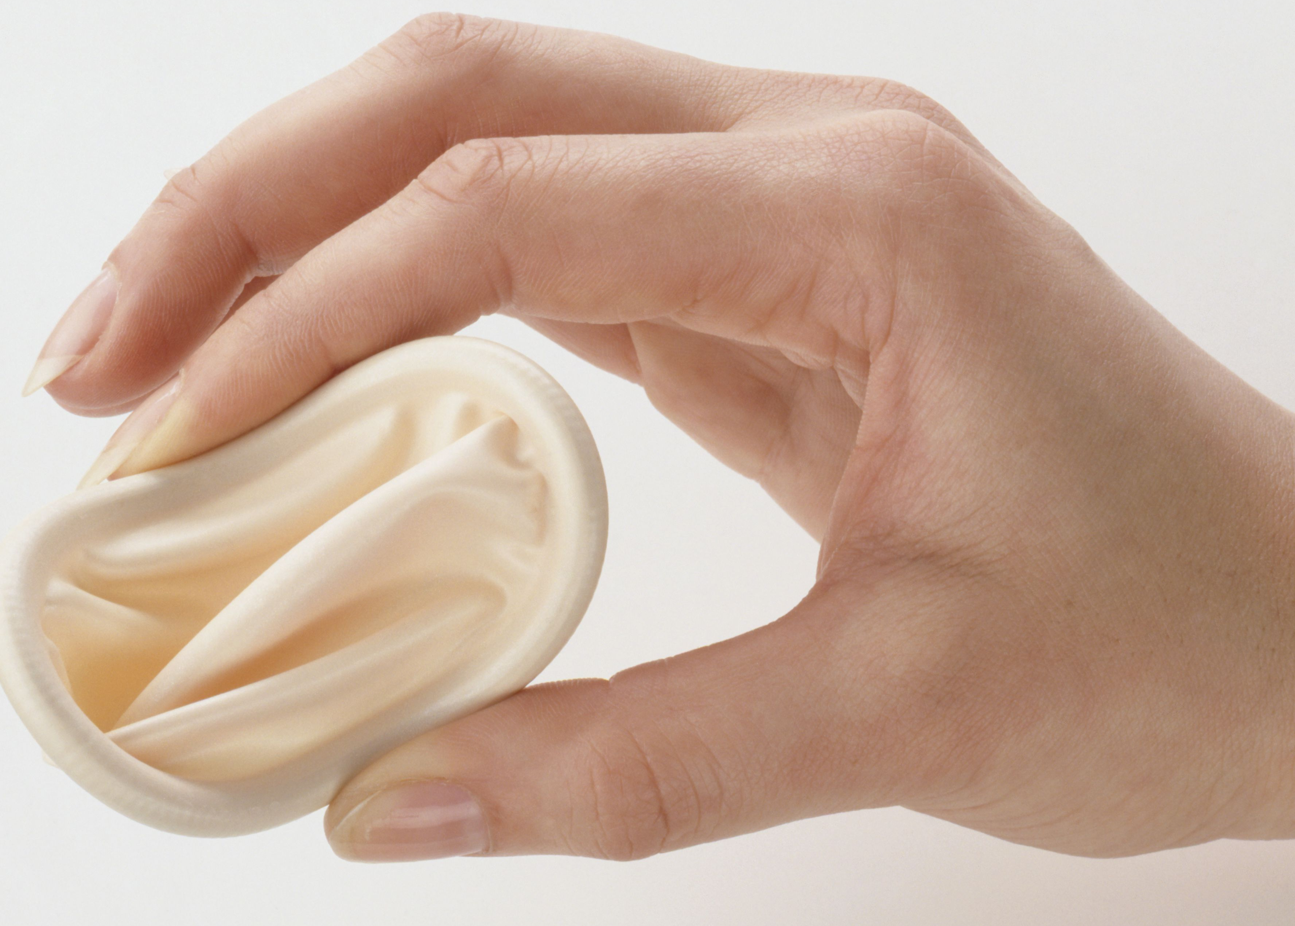
What is the Diaphragm and how does it work?
Shallow, bendable cup that is placed inside the vagina, against the cervix
Covers cervix during sex to prevent pregnancy
Possible to add spermicide to your diaphragm before injecting to make it more effective
Chemicals that stop sperm from moving and attaching to the egg

Slide 30
The Diaphragm
Advantages
Reusable
Inexpensive
Rarely hinders sexual experience
Disadvantages
Requires consistent use each sexual encounter
Spermicidal agents applied may be messy
Difficulty inserting into vagina

Slide 31
What is Emergency Contraception?
AKA “morning after pill” or “Plan B”
Oral pills you can use to prevent pregnancy after having unprotected sex
There are many brands: how soon you need to take the pill after sex depends on the brand. Be sure to read the instructions carefully or contact your healthcare provider for help.
Safe and effective, but not ideal as a regular form of contraception
Does not protect against STIs
Where can I get Emergency Contraception?
Some brands are available over-the-counter in Michigan… just go to the pharmacy! No prescription or appointment needed.
CHC can assist if you have questions or need help taking or finding the medication.

Slide 32
Is Emergency Contraception (EC) an abortion pill?
EC methods DO NOT cause abortions.
They prevent ovulation, fertilization, or implantation.
If a person is already pregnant (fertilized egg has implanted into the uterus) EC will not work because it needs to be used before the egg attaches
If the person is pregnant, studies have found no increased risk to a fetus from use of EC pills.

Slide 33
Some things to consider when choosing which method is right for you…
Do I ever want a pregnancy and if so, when?
What do I value most in a method?
Effectiveness
Cost
Easy to use
Discreet
Is it important for me to have a period every month?
Do I want non-contraceptive benefits, like lighter, less painful periods or less acne?

Slide 34
PrEP: Safe and effective HIV prevention
Advantages
Disadvantages
One daily pill reduces risk of becoming HIV positive (if exposed through sex) by about 92%, is even more effective with consistent condom use
Often covered by insurance, or many patients qualify for financial assistance through manufacturer programs
Available at CHC
Safe and effective
Possible side effects include stomach upset, loss of appetite, headache, kidney dysfunction
HIV testing required every three months while taking PrEP, must discontinue if patient becomes HIV positive
Must take at same time every day for maximum effectiveness
May take up to 21 days to reach maximum protection levels vaginal tissue and about 7 days for other body sites
Does not protect against other STIs
Notes:
7 days to reach protective levels for anal sex
92% from the Iprex trial (MSM) 90% for heterosexual sex.

Slide 35
A Final Note: Anonymous Partners and “Hook Up Culture”
Research shows “Hook Up Culture” is not new: but apps make it easier.
Reminder: using alcohol or drugs can influence your decision to not use condoms or encourage you to engage in sex with someone you wouldn’t otherwise have sex with.
If you hook up with an anonymous partner (someone you don’t know) it might be a good idea to get tested afterward.
Just because someone says they are STI-negative on their profile does not mean they are telling the truth or that it is from a recent test. Ask to see their paperwork or get tested together!
Not all STIs are curable: it only takes once!
Notes:
Research indicates “hook up culture”, or frequent sex acts with non-monogamous partners, is not new to this generation. But apps certainly make it easier to engage!

Slide 36
Still Have Questions?
Make an appointment with the Campus Health Center
Use MyMethod from Planned Parenthood to evaluate which birth control method is best for you. Simply search “MyMethod Planned Parenthood” into any search engine
Use www.bedsider.org for up-to-date information and assistance in finding a birth control method tailored for you needs
Notes:
- Make an appointment and review which options are best for you
Ask for and answer any questions.
If you don’t know the answer, get asker’s email and follow up with them after finding out answer.

