Slide 1
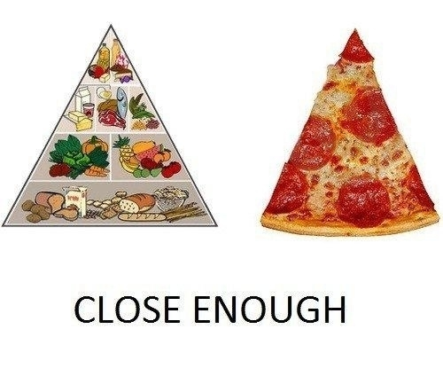
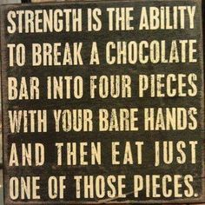
Nutrition 101
Notes:
Today we will talk to you about nutrition:
The basics of MyPlate
The food groups and how much of each to eat
How to plan your meals
How to snack smart
What to look for on food labels, and
How to shop healthily while on a budget at the grocery.
We should try our best to eat whole foods rather than refined foods that comprise the majority of our diet today. We will talk about shopping on a budget as well, as it is possible to afford whole foods on the budget of a college student.

Slide 2
The Evolution of Nutrition
1943
Basic 7
&
Basic 4
Notes:
Nutrition recommendations from the United States Department of Agriculture have changed over the decades as have the graphics used to represent those recommendations.
From 1943-1992, the “Basic 7” and the “Basic 4” were used to display food recommendations. The Basic 7 was used to maintain nutritional standards among wartime rationing in World War II and had very specific categories, like “green and yellow vegetables” and “oranges, tomatoes, grapefruit”. The Basic 4 made the categories more general into “vegetables and fruits”, “milk”, “meat”, and cereals and breads” instead of very specific ones.

Slide 3
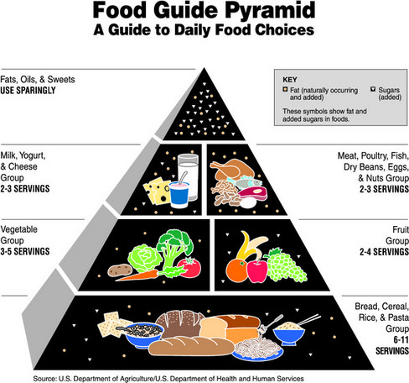
The Evolution of Nutrition
1992
Food Pyramid
Notes:
What the Basic 7 and Basic 4 did not do was provide a recommendation of servings of each food group, which the Food Guide Pyramid in 1992 focused on. Bread, cereal, rice and pasta occupied the large base of the pyramid followed by vegetables and fruits, then milk, yogurt and cheese and meat, poultry, fish, dry beans, eggs, and nuts, and finally fats, oils and sweets at the smallest portion on the top (to be used sparingly). Inside each group were several images of representative foods, as well as symbols representing the fat and sugar contents of the foods.
The original Food Guide Pyramid was not without controversy. The first chart suggested to the USDA by nutritional experts in 1992 featured fruits and vegetables as the biggest group as the base, not breads. This chart was overturned at the hand of special interests in the grain, meat, and dairy industries, all of which are heavily subsidized by the government. If Americans followed the chart as suggested, they would buy much less meat, milk, and bread, as these were not as heavily promoted by nutritional experts as fruits and vegetables.

Slide 4
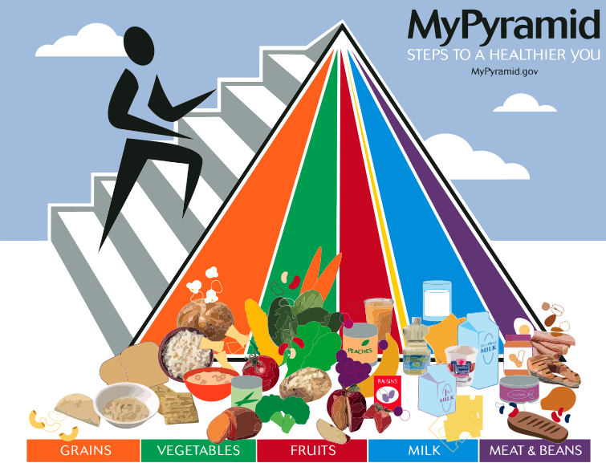
The Evolution of Nutrition
2005
MyPyramid
Notes:
In 2005, the USDA tried to make the pyramid more attractive, changing it into colorful vertical wedges. Stairs were added up the left side of the pyramid with an image of a climber to represent a push for exercise. The share of the pyramid allotted to grains now only narrowly edged out vegetables and milk, which were of equal proportions. Fruits were next in size, followed by a narrower wedge for protein and a small sliver for oils. An unmarked white tip represented discretionary calories for items such as candy, alcohol, or additional food from any other group.

Slide 5
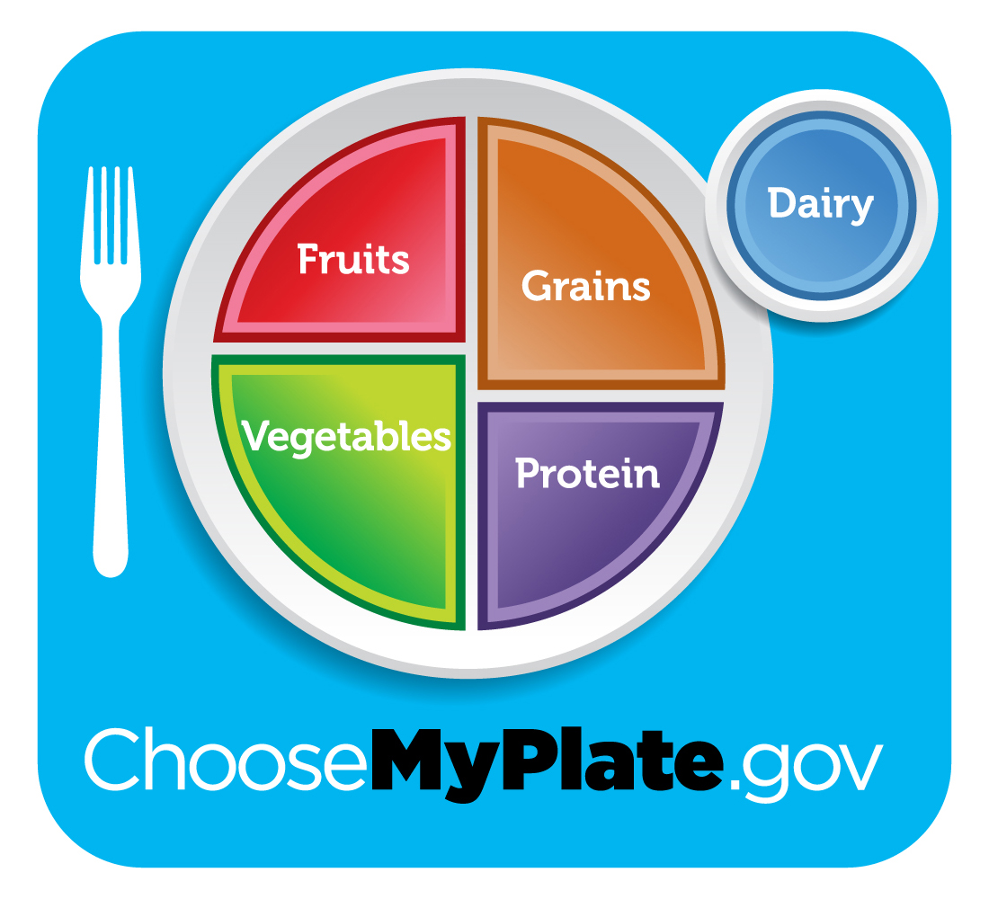
The Evolution of Nutrition
2019
MyPlate
Notes:
MyPlate is the current nutrition guide published by the USDA. MyPlate replaced the previous food pyramids that were either incorrect in their serving promotion or too abstract for consumers to understand. MyPlate is a simple diagram that tells you how your plate should look, as some people are too busy to count out weights of their food every time they eat.
MyPlate is supplemented with additional recommendations, such as:
"Make half your plate fruits and vegetables”
"Switch to 1% or skim milk”
"Make at least half your grains whole"
"Vary your protein food choices“
Portion control
Mindfulness to focus on enjoying food (even in smaller amounts), and
Reductions in sodium and sugar intakes and avoiding SoFAS (Solid Fats and Added Sugars)
Are you familiar with MyPlate already?
Where have you seen it?
Does your typical plate look like this? Why or why not?

Slide 6
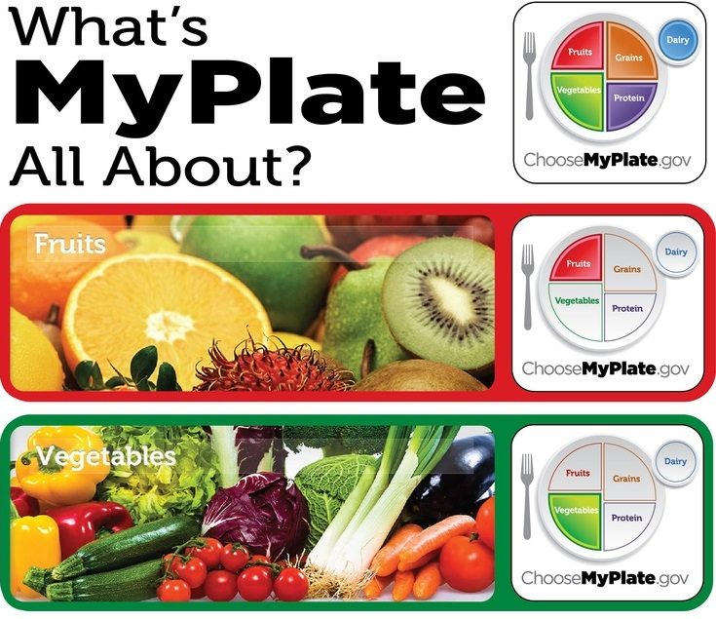
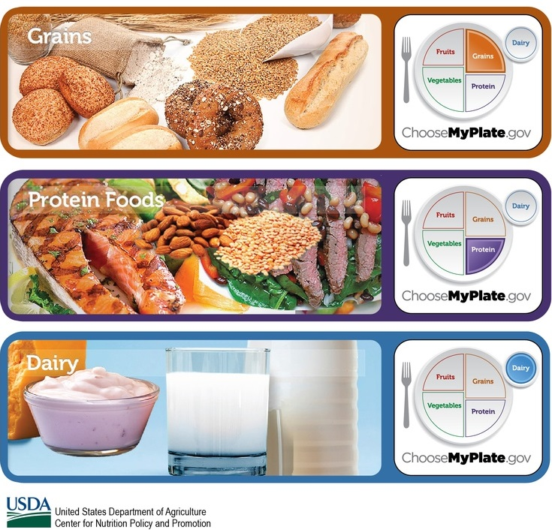
The Food Groups
Notes:
We will now talk about the food groups that MyPlate represents.
Before presenting each food group I will ask you a question relating to that food group.
(If we are giving away swag) The first person who gets the answer correct will win a prize.

Slide 7
Q: True or false: Fruit juice is just as nutritious as whole fruit. Why true or false?
A: FALSE! Greater consumption of specific whole fruits, particularly blueberries, grapes and apples, is significantly associated with a lower risk of type 2 diabetes, whereas greater consumption of fruit juice is associated with a higher risk. Why?
Fruit juice normally has a lot of sugar, nutrients and fiber are lost in the juicing process, and some “fruit drinks” do not actually have much fruit in them! The best choice is a piece of whole fruit and a glass of water.
To illustrate just how much better whole fruit is than fruit juice, the average orange is 45 calories with 100% of Vitamin C and 2.3 g (9% daily value) of fiber, while a bottle of 100% natural orange juice with no added sugar is 240 calories and no fiber.
Notes:
Q: True or false: Fruit juice is just as nutritious as whole fruit. Why true or false?
A: FALSE! Greater consumption of specific whole fruits, particularly blueberries, grapes and apples, is significantly associated with a lower risk of type 2 diabetes, whereas greater consumption of fruit juice is associated with a higher risk. Why?
(Let students answer question)
Fruit juice normally has a lot of sugar, nutrients and fiber are lost in the juicing process, and some “fruit drinks” do not actually have much fruit in them! The best choice is a piece of whole fruit and a glass of water.
To illustrate just how much better whole fruit is than fruit juice, the average orange is 45 calories with 100% of Vitamin C and 2.3g (9% daily value) of fiber, while a bottle of 100% natural orange juice with no added sugar is 240 calories and no fiber.

Slide 8
Food Groups
Fruits
Vegetables
1 ½ - 2 servings per day
Examples of 1 serving:
1 cup berries
1 medium apple
¼ cup dried fruit
1 cup diced watermelon
2 – 3 servings per day
Examples of 1 servings
1 cup broccoli
2 cups fresh spinach
½ cup cooked greens
Fist or baseball = 1 cup
Notes:
According to MyPlate, half of your plate should consist of fruits and vegetables.
You want to aim for 1 ½ - 2 servings of fruits per day and 2 – 3 servings of vegetables per day.
Eating a diet rich in vegetables and fruits as part of an overall healthy diet may reduce risk for heart disease, including heart attack and stroke, and protect against certain types of cancers.
Eating a diet rich in some vegetables and fruits as part of an overall healthy diet may protect against certain types of cancers.
Diets rich in foods containing fiber, such as some vegetables and fruits, may reduce the risk of heart disease, obesity, and type 2 diabetes.
Eating vegetables and fruits rich in potassium as part of an overall healthy diet may lower blood pressure, and may also reduce the risk of developing kidney stones and help to decrease bone loss.
Eating foods such as vegetables that are lower in calories per cup instead of some other higher-calorie food may be useful in helping to lower calorie intake.
Instead of sticking to only one or two types of fruits or vegetables, try to vary them as much as possible in type and also color in order to maximize the diversity of nutrients you are getting from them.

Slide 9
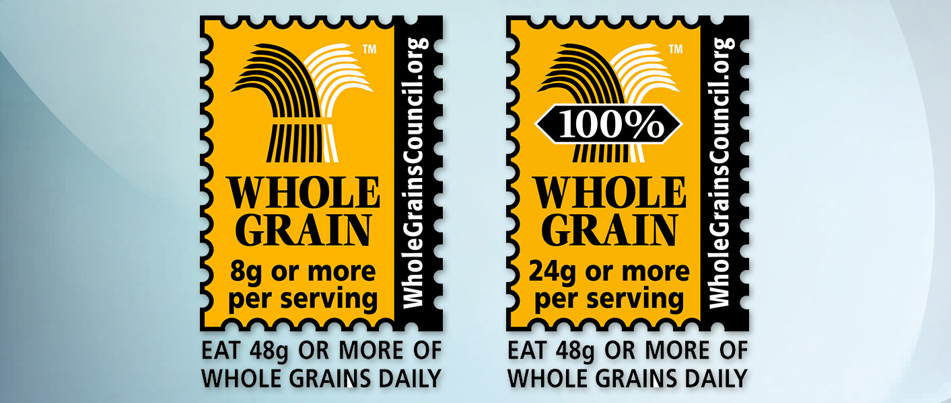
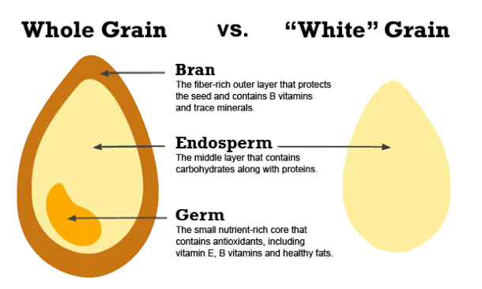
Q: True or false: All grains are equal Why true or false?
A: FALSE! Refined grains should be avoided as they have been stripped of their nutritious parts.
Beware labels that claim to be “multigrain,” “whole wheat,” or “whole grain” as they can be misleading and do not necessarily mean you are getting a nutritious product.
Look at the ingredients of the product and make sure “whole wheat” or “whole wheat flour” is the first ingredient.
When choosing whole grains, opt for those that are high in fiber.
Healthy whole grain choices include whole-wheat flour, quinoa, bulgur, oatmeal, whole cornmeal, and brown rice.
Notes:
Q: True or false: All grains are equal. Why true or false?
(Let students answer question)
A: FALSE! Refined grains should be avoided as they have been stripped of their nutritious parts.
Beware labels that claim to be “multigrain,” “whole wheat,” or “whole grain” as they can be misleading and do not necessarily mean you are getting a nutritious product.
Look at the ingredients of the product and make sure “whole wheat” or “whole wheat flour” is the first ingredient.
When choosing whole grains, opt for those that are high in fiber.
Healthy whole grain choices include whole-wheat flour, quinoa, bulgur, oatmeal, whole cornmeal, and brown rice.
Also, look for the Whole Grains Council Stamp on the packaging that guarantees consumers at least half a serving of whole grains. The stamp may be on the front, sides, or back of the packaging. The “100%” on the stamp means you are actually getting the whole grain – the bran, the germ, and the endosperm.

Slide 10
Food Groups
Aim for at least half your grains whole grains
5 – 8 servings per day
Examples of 1 serving:
1, 6-inch tortilla
1 slice bread
½ cup cooked pasta, rice, or cereal
1 cup ready-to-eat breakfast cereal
5 whole grain crackers
Fist or baseball = 1 cup
Notes:
According to MyPlate, about a quarter of your plate should consist of grains.
You want to aim for 5 – 8 servings of grains per day and try to get at least half of those servings as whole grains.
Whole grains are packed with nutrients, including protein, fiber, B vitamins, antioxidants, and trace minerals (iron, zinc, copper, and magnesium). Studies show that eating whole grains instead of refined grains lowers the risk of many chronic diseases. A diet rich in whole grains has been shown to reduce the risk of heart disease, type 2 diabetes, obesity, and some forms of cancer.
While benefits are most pronounced for those consuming at least 3 servings of whole grains daily, some studies show reduced risks from as little as one serving daily. The message: every whole grain in your diet helps!

Slide 11
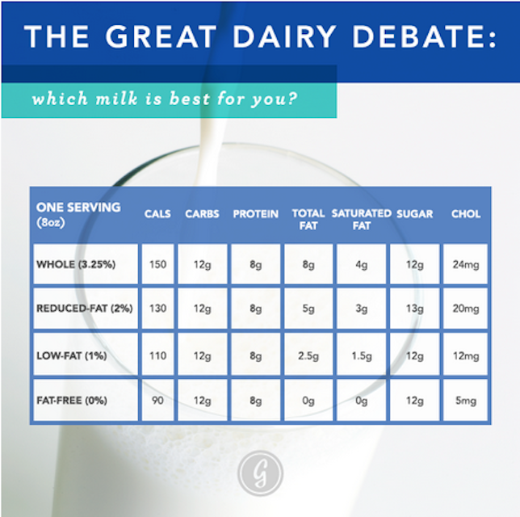
Q: True or false: Whole dairy is as healthy as fat-free dairy. Why true or false?
A: The answer is complicated.
Skim dairy is more “nutrient dense” than whole dairy, meaning that, for example, you receive more nutrients per calorie from skim milk than you do from whole milk.
However, volume for volume, other than fat the nutrients in whole dairy are the same as low-fat and fat-free dairy.
The FDA recommends choosing fat-free or low-fat milk, yogurt, and cheese.
Notes:
Q: True or false: Whole dairy is as healthy as fat-free dairy. Why true or false?
(Let students answer question)
A: The answer is complicated.
Skim dairy is more “nutrient dense” than whole dairy, meaning that, for example, you receive more nutrients per calorie from skim milk than you do from whole milk.
However, volume for volume, other than fat the nutrients in whole dairy are the same as low-fat and fat-free dairy.
In this chart notice how every other macronutrient other than fat is the same among different types of dairy.

Slide 12
Food Groups
Choose low fat or fat free
3 servings per day
Examples of 1 serving:
1 cup yogurt
1 ½ ounces low fat cheese
2 cups cottage cheese
1 cup calcium-fortified soy beverage or other dairy alternative
Fist or baseball = 1 cup
Notes:
According to MyPlate, you want to aim for 3 servings of dairy products per day.
Intake of dairy products is linked to improved bone health, and may reduce the risk of osteoporosis. Dairy products are known for calcium but also contain vitamin D, and protein as well.
The intake of dairy products is especially important to bone health during childhood and adolescence, when bone mass is being built.
Intake of dairy products is also associated with a reduced risk of cardiovascular disease and type 2 diabetes, and with lower blood pressure in adults.
Choosing foods from the Dairy Group that are high in saturated fats and cholesterol can have health implications. Diets high in saturated fats raise "bad" cholesterol levels in the blood. The "bad" cholesterol is called LDL (low-density lipoprotein) cholesterol. High levels of LDL cholesterol increase the risk for coronary heart disease. Many cheeses, whole milk, and products made from them are high in saturated fat. To help keep blood cholesterol levels healthy, limit the amount of these foods you eat and look at food labels to see how much saturated fat is in a food. In addition, a high intake of fats makes it difficult to avoid consuming more calories than are needed.

Slide 13
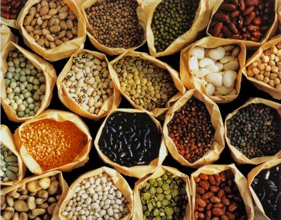
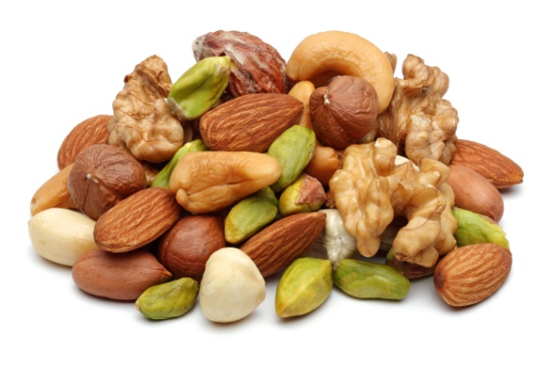
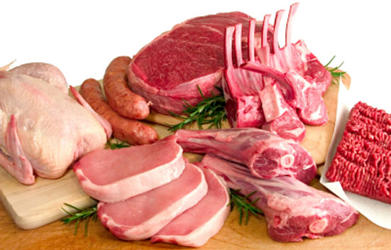
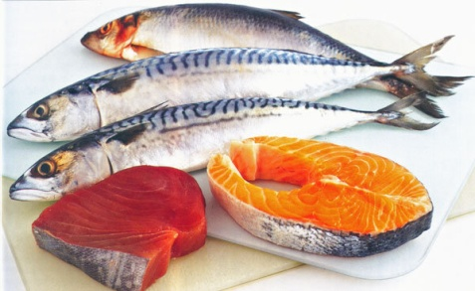
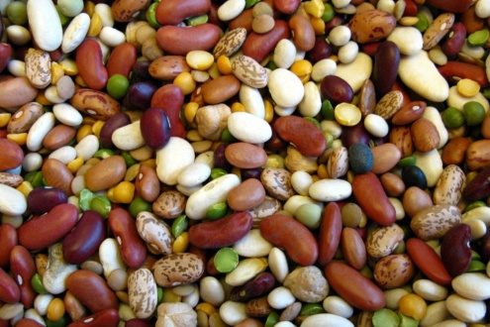
Q: What are some foods in the protein category?
Meat
Poultry
Fish
Dairy Products
Eggs
Nuts
Seeds
Dried Beans
Notes:
Q: What are some foods in the protein category?
(Let students answer)
Foods that provide protein include meat, poultry, fish, dairy products, eggs, nuts, seeds, and dried beans.

Slide 14
Food Groups
Aim for lean protein most often
5 – 6 ½ servings per day
Examples of 1 serving:
1 ounce cooked meat, poultry, or fish
¼ cup cooked dry beans
1 large egg
1 tablespoon nut butter
½ ounce nuts
¼ cup tofu
Palm of your hand or deck of cards = 2 – 3 oz
Notes:
According to MyPlate, about a quarter of your plate should consist of proteins.
You want to aim for 5 – 6 ½ servings of proteins per day.
Meat, poultry, fish, dry beans and peas, eggs, nuts, and seeds supply many nutrients. These include protein, B vitamins (niacin, thiamin, riboflavin, and B6), vitamin E, iron, zinc, and magnesium.
Proteins function as building blocks for bones, muscles, cartilage, skin, and blood. They are also building blocks for enzymes, hormones, and vitamins. Proteins are one of three nutrients that provide calories (the others are fat and carbohydrates).
B vitamins found in proteins serve a variety of functions in the body. They help the body release energy, play a vital role in the function of the nervous system, aid in the formation of red blood cells, and help build tissues.
Protein also keeps you feeling full longer so you are likely to eat less.
Iron is used to carry oxygen in the blood. Many teenage girls and women in their child-bearing years have iron-deficiency anemia. They should eat foods high in heme-iron (meats) or eat other non-heme iron containing foods along with a food rich in vitamin C, which can improve absorption of non-heme iron.
Magnesium is used in building bones and in releasing energy from muscles.
Zinc is necessary for biochemical reactions and helps the immune system function properly.
Try to get 8 ounces of seafood per week. Seafood contains a range of nutrients, notably the omega-3 fatty acids, EPA and DHA. Eating about 8 ounces per week of a variety of seafood contributes to the prevention of heart disease. Smaller amounts of seafood are recommended for young children.
Seafood varieties that are commonly consumed in the United States that are higher in EPA and DHA and lower in mercury include salmon, anchovies, herring, sardines, Pacific oysters, trout, and Atlantic and Pacific mackerel (not king mackerel, which is high in mercury). The health benefits from consuming seafood outweigh the health risk associated with mercury, a heavy metal found in seafood in varying levels.

Slide 15
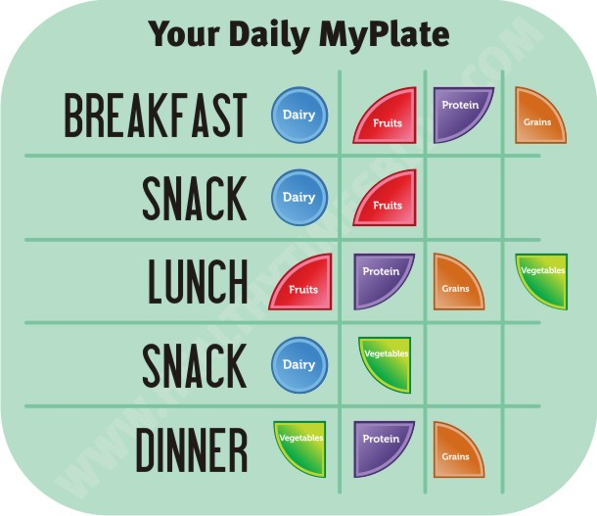
Meal Planning
Notes:
This is a rough template of how to break down the food groups throughout the day.
Eat every 3 – 5 hours.
Eat breakfast within 1 -2 hours of waking to fuel your body for the day.
If you do not have time for a meal, try replacing it with two smart snacks.

Slide 16
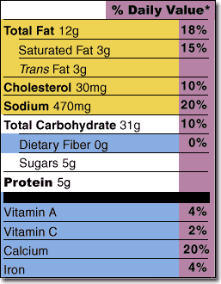
Q: What are important things to look for on food nutrition facts labels?
A: Use Nutrition Facts labels and ingredient lists to find:
Saturated fat
Sodium
Sugars
Fiber
Look for food and drink choices that are lower in saturated fat, sodium, and added sugar.
Avoid Solid Fats and Added Sugars (SoFAS) and excessive sodium
Notes:
Eating fewer calories from foods high in saturated fat and added sugars can help you manage your calories and prevent weight gain and obesity. Most of us eat too many foods that are high in saturated fat and added sugar.
Eating foods with less sodium can reduce your risk of hypertension/high blood pressure.
Remember the term “SoFAS” which stands for Solid Fats and Added Sugars. You want to avoid SoFAS as much as possible.
Dietary fiber helps maintain blood sugar levels and bowel health.

Slide 17
Grocery Shopping Tips
Plan ahead – make a list and try not to stray from it
Look at the weekly ad for deals and coupons
Shop the perimeter of aisle – the healthier, more wholesome food` is on the outside while the junk gets worse the further in you go
NEVER, EVER shop while hungry
Only buy what you need
Try using a hand basket
Notes:
Plan ahead by making a list of what you need. When you write down what you need you will be less likely to write down junk food. When you are actually in the store, try not to stray from the list and avoid the temptation of junk food.
Look at the weekly circular ads for the current deals and coupons. Grocery stores often have sales on healthy foods, you just have to look for them.
Shop the perimeter of aisle. The healthier, more wholesome foods like fruits, vegetables, meats, and dairy are on the outside while unhealthy refined foods become more prevalent the further into the middle you go.
Never, ever, ever, ever shop while hungry. Before you know it you will have a cart full of junk food you don’t need, but desire because you are hungry at that moment.
Only buy what you need. Save your money and health by sticking to necessities. If you don’t have junk food available in your kitchen to eat you won’t have to worry about it.
If you don’t plan on buying a lot of food, try using a hand basket instead of a cart to minimize what you purchase.

Slide 18
Shopping On A Budget
Buying food in bulk is more expensive up front but saves you money in the long term
Purchase produce that is about to expire and either eat it immediately or freeze it for future use
Boxes, bags and cans that are damaged are marked down
Pay with cash
Use the food you have before getting more
Return your cans
Shop at farmer’s markets for cheap, healthy, local produce
Notes:
College students are known for being poor and eating Ramen as their staple food. These are some tips to shop on a budget.
Buying food in bulk is more expensive up front but saves you money in the long term. If you commute and have access to a Costco or a Sam’s Club that is great, but a lot of groceries have bins where you can scoop food in bulk.
Purchase produce that is about to expire and either eat it immediately or freeze it for future use. These foods are marked down quite a bit.
Boxes, bags, and cans that are dented or scratched are marked down. This can save you money on dry beans, grains, oils, nuts, soups, etc.
Paying with cash will prevent you from overspending with a credit card and make you prioritize what you really need. Do you really need that ice cream? Milk would be a better option.
We often buy food while we still have ample stores left in our fridge, freezer, and pantry. Make your money go further by eating what you have before buying more.
Hopefully you don’t drink pop or energy drinks, but if you, your family, or roommates do, don’t forget to return your cans. In Michigan, recycling aluminum, plastic, and glass containers gives you 10 cents each. This can add up quickly, and the coupon you get saves you money instantly on that grocery trip.
Shopping at farmer’s markets can save you money on healthy food. Wayne State has a weekly Farmer’s Market that runs from the summer through the fall.

Slide 19
Smart Snacking
What is a snack?
Approximately 200 calories
Carbohydrate + Protein
Examples:
1 Tbsp peanut butter + medium apple
20 almonds, mini box of raisins and ¼ cup sunflower seeds
Toaster waffle with ½ cup blueberries and 2 Tbsp low-fat yogurt
6 whole wheat crackers and 1 slice low fat cheese
1, 6-inch tortilla with ¼ cup black beans and 2 Tbsp salsa
Notes:
Snacking is okay as long as you make good choices.
Smart snacking can help maintain and regulate a steady blood sugar level and keep you from the energy crashes that happen at various points throughout the day.
Smart snacking is also important to keep you from binging later in the day.

Slide 20
Q: How much water should you drink per day?
Previously, the recommendation used to be eight glasses of eight ounces of water which equals 64 ounces of water per day.
The new recommendation is to take whatever you weigh in pounds and to consume at least half of that number in ounces of water.
For example, if I weight 200 pounds I want to consume at least 100 ounces of water per day.
Increase the amount of water with increased temperature and physical activity.
Notes:
Q: How much water should you drink per day?
(Let students answer)
Previously, the recommendation used to be eight glasses of eight ounces of water which equals 64 ounces of water per day.
The new recommendation is to take whatever you weigh in pounds and to consume at least half of that number in ounces of water.
For example, if I weight 200 pounds I want to consume at least 100 ounces of water per day.
Increase the amount of water with increased temperature and physical activity.

Slide 21
Fluids
Water
Traditionally, taught 8 cups (64 oz) daily, but…
Aim for half your body weight (in pounds) in ounces
Sugary beverages
Reduce or eliminate!
Pop, juice, lemonade, sweet tea, energy drinks, etc.
Caffeinated drinks
Coffee
95 mg caffeine per 8 oz
Tea
Green tea: 25 mg caffeine per 8oz
Black tea: 47 mg caffeine per 8oz
Soda averages 29 mg caffeine per 12 oz
Notes:
Up to 60% of the body is water. Individually, the brain and heart are composed of 73% water, and the lungs are about 83% water. The skin contains 64% water, muscles and kidneys are 79%, and even the bones are watery at 31%.
With all this being said, why would you not want to hydrate sufficiently? Along with whole foods, water is the essential fuel for your body that you must consume to perform at your physical and mental peak.
Again, try to get at least half your body weight (in pounds) in ounces of water. More would be necessary after working out or during hot days. An easy check is to examine the color of your urine when using the bathroom – clear urine means you are sufficiently hydrated, while darker shades mean you need to hydrate as soon as possible.
If you’re thirsty, it’s usually too late and means you’re already in a dehydrated state, so try to get ahead of thirst.
Sugary beverages are empty calories you should work to reduce and eventually eliminate completely. They have very little nutritional content, rot your teeth, promote weight gain, and are expensive in the long run.
Coffee and tea are okay in moderation. Up to 400 mg of caffeine a day appears to be safe for most healthy adults. That's roughly the amount of caffeine in four cups of brewed coffee, 10 cans of cola or two "energy shot" drinks.
Caffeine has been scientifically proven to promote concentration and improved physical performance, but too much can fatigue your nervous system and leave you jittery, while also ruining your sleep schedule. If you consume caffeinated products, ensure that you do so before noon so it works its way out of your system by the evening. Energy drinks will be talked about shortly.

Slide 22
Notes:
According to the American Heart Association, the maximum amount of added sugars you should consume in a day are 37.5 grams for men and 25 grams for women.
A bottle of Vitamin Water has as much sugar as a can of Coke at 40 grams of sugar.
Snapple markets its brand as “all natural” but a 16 ounce glass has over 50 grams of sugar.
Sports drinks like Gatorade or Powerade are only necessary after vigorous intensity exercise that has lasted an hour or more. If you are working out for less time than that or are only doing moderate intensity exercise, water will suffice.

Slide 23
Liquids Affect You Differently than Solid Food
Notes:
Scientific evidence confirms that although liquids count as calories, the body doesn't detect them the same way as it would detect solid food.
Fluid calories do not hold strong satiety properties, don't suppress hunger and don't elicit compensatory dietary responses
Liquids do not take as much room in the stomach as solid foods, so you can consume more without feeling full. This leads to an excessive consumption of sugar without even realizing it.
According to the American Heart Association, the maximum amount of added sugars you should eat in a day are 37.5 grams for men and 25 grams for women. Looking at these graphics, an eight-ounce can of Coke is already beyond this.
According to Dr. Stephan Guyenet, in the year 1822 we ate the sugar equivalent of a 12 ounce can of soda every 5 days. Today, we’re eating the equivalent of a 12 ounce can of soda every 7 hours.
On average, Americans are eating about 22 teaspoons of added sugar per day, or 355 calories. This amounts to 70 pounds per year! Keep in mind that these are averages. Young males are eating about a 100 pounds of sugar per year… and many individuals are eating much, much more.
If a daily pop drinker cuts out one 12-ounce pop every day and maintains everything else, they would lose 15 pounds in a year! Not only that, but they will save money as well.

Slide 24
Energy Drinks
Notes:
Up to 400 mg of caffeine a day appears to be safe for most healthy adults. That's roughly the amount of caffeine in four cups of brewed coffee, 10 cans of cola or two "energy shot" drinks.
A typical energy drink contains between 50 and 500 mg of caffeine per can/bottle. 500 mg is like drinking 14 cans of pop or 5 strong cups of coffee.
However, other than caffeine, the amount of “energizing” ingredients in most energy drinks are generally too low to notice a benefit.
Most energy drinks are loaded with sugar, from which you will have an energy crash afterwards, defeating the purpose of the product. The excessive sugar in energy drinks will also give you cavities. Even sugar-free versions have supplements that are toxic to you in high doses.
This is what happens when you reach levels of vitamin toxicity from energy drinks:
Vitamin B3 Toxicity: Flushing of skin, itching, impaired glucose tolerance, nausea, liver toxicity and gastrointestinal upset. Intake of 750 mg per day for less than 3 months can cause liver damage.
Vitamin B5 Toxicity: Nausea, heartburn and diarrhea.
Vitamin B6 Toxicity: Painful neurological symptoms.
Mixing energy drinks and alcohol can lead to heart rhythm disturbances and false assumptions regarding your level of intoxication. Further, alcohol and energy drinks lead to higher blood lactate, blood pressure and stress hormones. Students have died drinking Four Lokos energy/alcoholic drinks.
These are questions to ask yourself before using energy drinks as a supplement:
How is your nutrition?
Are you getting adequate sleep
Are you taking medications with side effects?
- Are you exercising regularly?
The best bet is to avoid energy drinks altogether. However, if you MUST have an energy drink, like all caffeinated products you should consume it prior to noon so it will work its way out of your system by the evening.
Energy drinks are also expensive in the long run. Using a water fountain on campus gives you a healthier product for free.

Slide 25
Q: How much aerobic physical activity should someone aged 18+ get per week?
Adults should aim to get at least 150 minutes of moderate intensity physical activity (dose-response)
This is only 30 minutes per day for five days
These 30 minutes can be broken down into three 10 minute segments throughout the day if time is an issue
You can perform vigorous intensity physical activity and meet the recommendation in half the time (75 minutes per week)
Muscle strengthening exercises should be performed at least twice a week that work all major muscle groups (legs, hips, back, abdomen, chest, shoulders, and arms)
Notes:
Q: How much aerobic physical activity should someone aged 18+ get per week?
(Let students answer)
Adults should aim to get at least150 minutes of moderate intensity physical activity. There is a dose-response relationship, meaning that the more physical activity one does, the more health benefits they receive.
This is only 30 minutes per day for five days, and these 30 minutes can be broken down into three 10 minute segments throughout the day if time is an issue. Try doing air squats, push ups, sit ups, jumping jacks, etc. during commercial breaks when watching television.
You can perform vigorous intensity physical activity and meet the recommendation in half the time (75 minutes per week). To compare intensity levels, moderate intensity physical activity is something like brisk walking, while vigorous intensity physical activity is something like jogging.
Muscle strengthening exercises should be performed at least twice a week that work all major muscle groups (legs, hips, back, abdomen, chest, shoulders, and arms).

Slide 26
Exercise
Eat before and after exercise!
Will lead to a better, more efficient work out
Helps build muscle
Try a snack 1 hour before or a small meal 2 – 3 hours before exercise
Be active YOUR way
Notes:
Nutrient timing can help with weight loss and also fuel performance in exercise. Try to consume your carbohydrates prior to and following workouts to maximize their effectiveness while minimizing excessive storage into your body. The supposed “post-exercise window” of 30-45 minutes after exercise is a myth, just try to eat as soon as possible after working out to replenish what you’ve used up.
Eat a snack and drink water prior to working out.
Be active your way – do physical activity that is enjoyable for YOU – it does not have to be in a traditional gym if you do not like being in a gym. You can play intramural sports, take yoga classes, or just go for a run outside. Working out with a friend or friends is also beneficial to your health. You will push each other and hold each other accountable.

Slide 27
Mort Harris Recreation and Fitness Center
Weights
Cardio machines
Basketball courts
Indoor track
FREE Group fitness classes
Personal training
Climbing wall
Intramural sports
Adventure trips
Pool @ Matthaei
Notes:
The Mort Harris Recreation and Fitness Center is something your tuition covers, so access to the gym is free for you as a student.
Alongside a variety of weight machines and free weights, the RFC has different types of cardio machines, a climbing wall, basketball courts, and an indoor track.
They offer personal training, group fitness classes, a wide variety of intramural sports, and adventure trips throughout the year.
The pool at Matthaei is also accessible to students, although the hours vary by semester and the swim team/swimming classes have priority.

Slide 28
Practical Tips
Use smaller plates, bowls, glasses, mugs, and utensils to create portion control
Eat slower – it takes about 20 minutes for satiety signals from your stomach to reach your brain
Eat with mindfulness – turn off distractions and be mindful of the taste, texture, and the nourishment of your food to make eating more enjoyable
Eat some foods less often – cut back on solid fats, added sugars (SoFAS), and salt
Notes:
Use smaller plates, bowls, glasses, mugs, and utensils to create portion control.
Eat slower – it takes about 20 minutes for satiety signals from your stomach to reach your brain.
Eat with mindfulness – turn off distractions and be mindful of the taste, texture, and the nourishment of your food to make eating more enjoyable.
Eat some foods less often – cut back on solid fats , added sugars (SoFAS), and salt.

Slide 29
Practical Tips
Eat some foods more often – choose nutrient dense foods and consume a variety of colors – you can’t go wrong with making half your plate fruits and vegetables
Head to class prepared with healthy snacks
Use the nutrition facts label to compare sodium, calories, fats, and sugars in your foods
Drink water – soda, energy drinks, sports drinks and sugar sweetened coffee are a major source of added sugar and calories in American diets
Notes:
Eat some foods more often – choose nutrient dense foods and consume a variety of colors – you can’t go wrong with making half your plate fruits and vegetables.
Head to class prepared with healthy snacks.
Use the nutrition facts label to compare sodium, calories, fats, and sugars in your foods.
Drink water – soda, energy drinks, sports drinks and sugar sweetened coffee are a major source of added sugar and calories in American diets.

Slide 30
Key Messages
Make half your plate fruits and vegetables
Enjoy your food, but eat less
Avoid oversized portions
Make at least half your grains whole
Drink water instead of sugary drinks
Compare the sodium in your foods
Switch to fat-free or low-fat (1%) milk
Notes:
Make half your plate fruits and vegetables.
Enjoy your food, but eat less.
Avoid oversized portions.
Make at least half your grains whole.
Drink water instead of sugary drinks.
Compare the sodium in your foods.
Switch to fat-free or low-fat (1%) milk.

Slide 31
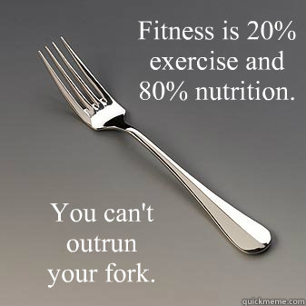
Questions?
313-577-5041
health.wayne.edu
9:00am – 5:30pm
Monday-Friday
Notes:
Ask for and answer any questions.
If you don’t know the answer, get asker’s email and follow up with them after finding out answer.

