Slide 1

Sexually Transmitted Infections
To increase the awareness of sexually transmitted infections (STIs) that threaten campus health.

Slide 2

Did you know?
There are 20 million new STIs cases each year in the U.S.
Notes:
https://www.youtube.com/watch?v=LtPD5vj33MM

Slide 3
Did you know?
1 of every 2 people will be infected with an STI between ages 15 to 24.
Notes:
https://www.youtube.com/watch?v=LtPD5vj33MM

Slide 4
Did you know?
Some STIs are curable, some are not.
Notes:
https://www.youtube.com/watch?v=LtPD5vj33MM

Slide 5
Did you know?
Most people with an STIs experience no symptoms.
Notes:
https://www.youtube.com/watch?v=LtPD5vj33MM

Slide 6
Did you know?
If left untreated, some STI can have serious impact.
Notes:
https://www.youtube.com/watch?v=LtPD5vj33MM

Slide 7

Options to decrease your risk of an STI
Barriers: condoms, dental dams
Vaccinating against HPV, hepatitis B
Regular testing
Reducing number of sex partners or
encouraging partners to be tested with
you before you engage in sex
Mutual monogamy
Abstinence or “outercourse” (touching,
cuddling, etc.)
This Photo by Unknown Author is licensed under CC BY-SA-NC

Slide 8

Get Yourself Tested (GYT)
Campus Health Center offers free Chlamydia and Gonorrhea testing to those who are eligible!

Slide 9

Common STI’s

Slide 10
Bacterial Vaginosis
Technically not an STI, but is associated with sexual activity
Occurs when there is too much of a certain bacteria in
the vagina (“good” and “harmful” bacteria is unbalanced)
Most people do not experience symptoms
Common among people15-44 years old

Slide 11
Bacterial Vaginosis
How to avoid:
Wash vulva with gentle soap and water
Avoid vaginal deodorants and washes
Only use water-based lubricants
Possible symptoms:
Thin white or gray vaginal discharge
Pain, itching around outside of vagina
Burning when urinating
Strong fish-like odor
Can it be cured?
It can be cured by medication/
antibiotic prescribed by a health
care provider
If left untreated:
Increases your chance of getting
HIV, Chlamydia, gonorrhea and
passing onto your partner
If pregnant, can cause premature
delivery of baby

Slide 12

Chlamydia
Common STI that can infect anyone
It is spread through vaginal, anal, or oral sex
Most people do not experience symptoms

Slide 13
Chlamydia
Possible symptoms:
Vagina: abnormal vaginal discharge,
burning sensation when urinating
Penis: burning urination, discolored discharge from penis, painful testicles
Can it be cured?
It can be cured by medication/
antibiotic prescribed by a health
care provider
Repeat infection is common
Important to get tested 3 months
after you are treated
If left untreated:
Uterus: it can spread to uterus
and fallopian tubes (effecting
fertilized eggs) causing pelvic
inflammatory disease and permanent damage to reproductive system
Penis: it can spread to the tube
carrying sperm from testicles,
causing pain and fever

Slide 14

Gonorrhea
Common STI that can infect anyone
Causes infections in genitals, rectum, and throat
Common among people 15-24 years old
Most people do not experience symptoms

Slide 15
Gonorrhea
Possible symptoms:
Vagina: burning urination, increased
vaginal discharge, unexpected bleeding between periods
Penis: discharge from penis, burning sensation when urinating, pain/swelling
in one or both testicles
Can it be cured?
It can be cured by medication/
antibiotic prescribed by a health
care provider
Drug-resistant strains of gonorrhea are increasing, and treatment is more difficult.
If left untreated:
Serious and permanent health
problems can occur
Vagina: untreated gonorrhea causes
pelvic inflammatory disease
Penis: pain in testicles, possible sterility
  Rarely will spread to blood or
  joints and can be life-threatening

Slide 16
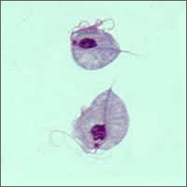
Trichomoniasis
Caused by infection with a protozoan parasite
called trichomonas vaginalis
Most common curable STI
Most people do not experience symptoms
Image courtesy of CDC.gov

Slide 17
Trichomoiasis
Possible symptoms:
Vagina: itching/burning/redness or
soreness of genitals, discomfort with urination, change in vaginal discharge
Penis: Itching/irritation inside penis, burning after urination or ejaculation, discharge from penis
Can it be cured?
It is the most common curable STI
Is treated with oral medication
It is possible to be re-infected
If left untreated:
Increases the risk of attracting/
spreading other STIs
Causes genital inflammation

Slide 18

Human Papillomavirus (HPV)
Most common STI
Caused by having vaginal, anal, or oral sex with
someone who has the virus
Possible to go away on its own not cause any health
problems but if it does not go away, may cause genital
warts and cancer
The vaccine protects against 9 strains of HPV that can
cause problems such as cancers and genital warts

Slide 19
Human Papillomavirus (HPV)
Possible symptoms:
Symptoms may develop years after
you have sex with an infected person
Can it be cured?
There is no cure for the virus, but your
body may clear it on its own
There are treatments for health problems HPV may cause (such as removing warts
and cancerous lesions)
If left untreated:
Can cause cervical and other cancers
  - Vulva, vagina, penis, anus
  - Back of the throat, base of
  tongue and tonsils

Slide 20
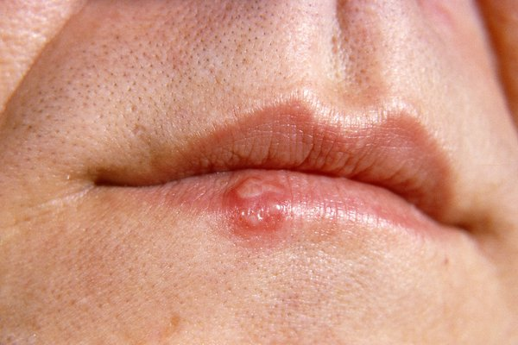
Herpes – HSV-1 and HSV
Genital (typically HSV-2) - Can be transferred through vaginal,
anal, or oral sex with someone that has ever had herpes or
cold sores
Oral (typically HSV-1) - Can be transferred from kissing,
sharing utensils, or having oral sex with someone who is infected
Either strain can affect either location!
Many people do not have symptoms
Herpes can be spread even when blisters are not present
Image courtesy of NHS.uk

Slide 21
Herpes
Possible symptoms:
Symptoms may develop years after
you have sex with an infected person
Can it be cured?
There is no cure for herpes
Medicine is available to prevent or
shorten outbreaks and decrease risk of passing onto partner
If left untreated:
Genital herpes can cause painful
genital sores and can be severe in
people with suppressed immune
systems
If you touch your sores or come
into contact with the sore fluid,
you may transfer it to another part
of your body (your eyes)
If you are pregnant, problems may
occur for you and your developing
newborn baby

Slide 22
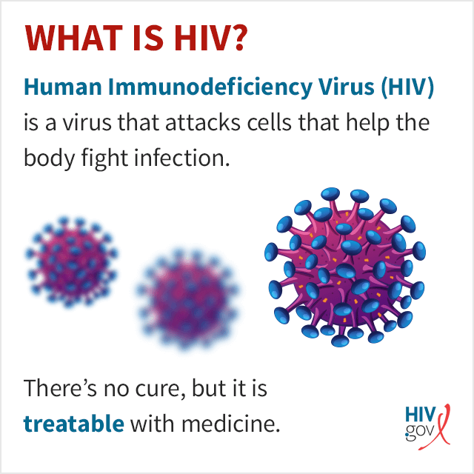
Human Immunodeficiency Virus (HIV)
Virus that attacks cells that help the body fight
infection
Transmitted through contact with infected
vaginal fluids, semen, or infected blood
Harms immune system by destroying white
blood cells that fight infection
Final stage: acquired immunodeficiency
syndrome (AIDS)

Slide 23
HIV
Can it be cured?
HIV currently is not curable
New treatments can make the viral load undetectable, virtually eliminating the chance of transmitting the virus to others (Undetectable=Untransmittable)
If left untreated:
Can lead to acquired immunodeficiency syndrome or AIDS
Reduced number of CD4 cells (T cells) which help the immune system fight off infections
Severe infections can cause death

Slide 24
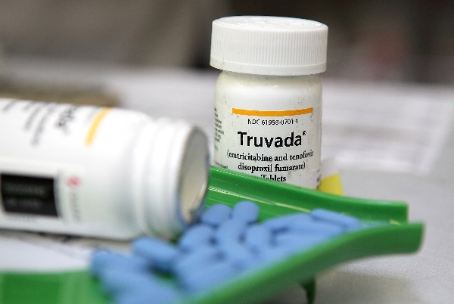
Pre-exposure Prophylaxis (PrEP)
Besides testing for STIs, including HIV, nurse practitioners at Campus Health Center prescribe HIV pre-exposure prophylaxis (PrEP).
PrEP is a once-a-day oral medication that when combined with safer sex practices, can reduce the risk of acquiring HIV by over 90%.
It can be taken by any HIV-negative person that wants to lower their chance of acquiring HIV.
Schedule a consultation appointment to learn more!
This Photo by Unknown Author is licensed under CC BY-ND

Slide 25
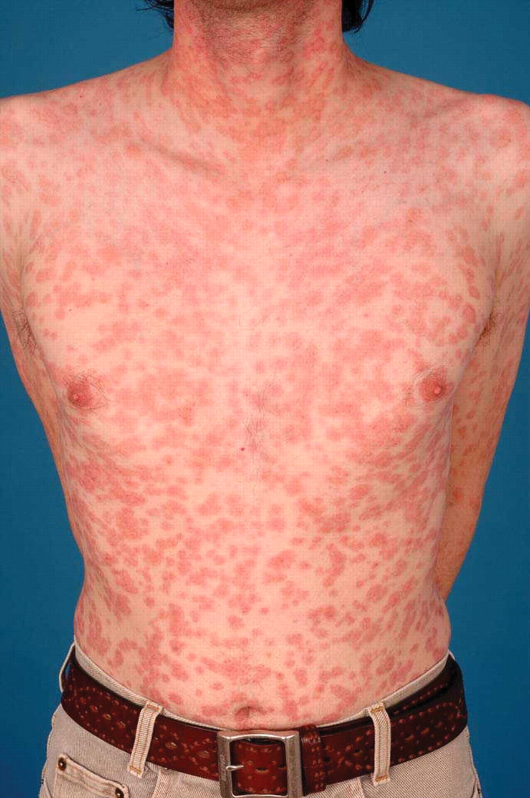
Syphilis
A sexually transmitted infection that can
cause serious health problems if not treated properly
Can occur 10-30 years after infection began

Slide 26
Syphilis
Possible symptoms:
Primary: you may notice single or multiple sores (firm, round, painless) lasting 3-6 weeks
Secondary: you may have skin rashes and/or mucous membrane lesions which are sores in your mouth/vagina/anus
Latent: period-of-time with no visible signs or symptoms
Tertiary: may affect many organ systems, including heart and blood vessels and the brain and nervous system
Can it be cured?
Yes, with the right antibiotics
Treatment might not undo any
damage that the infection has
already caused
If left untreated:
Without treatment, syphilis can spread to the brain and nervous system or to the eye
Severe headache, difficulty coordinating muscle movements, paralysis, numbness, and dementia

Slide 27
STILL HAVE QUESTIONS?
Call or go online and make an appointment with the Campus Health Center!
health@wayne.edu
313-577-5041
5285 Anthony Wayne Dr.
Detroit, Mi

