Slide 1
PrEP: Is it right for you?
Erika Blaskay, RN, BSN
Community Outreach Nurse, Campus Health Center

Slide 2

What is HIV?
Human Immunodeficiency Virus
  Virus that attacks the cells that help the body fight infection (CD4 lymphocytes).
  Treatable but not curable. No available vaccine.
  Different types and strains: HIV-1 and HIV-2 (aidsmap.com, 2020)
  Having another STI increases your risk of getting HIV x3 (CDC, 2020).
  Spread by coming into contact with blood or certain bodily fluids from a person who has HIV.
  Makes the person more vulnerable to other diseases.
    Opportunistic infections (OI): occur in people who don’t have the ability to fight them off.
      Pneumonia
      Certain types of cancers
      Candidiasis (fungal infections)
  Stages of HIV (CDC, 2020)
    I. Acute HIV Infection: flu-like symptoms, highly contagious, high viral load
    II. Chronic HIV Infection: no symptoms, can transmit to others if not treated, can live here for years, especially when treatment is effective. Undetectable = Untransmittable
    III. AIDS: high viral load, highly contagious, very susceptible to OI. Life expectancy of 3 years without treatment.
Image courtesy of Imperial College of London

Slide 3
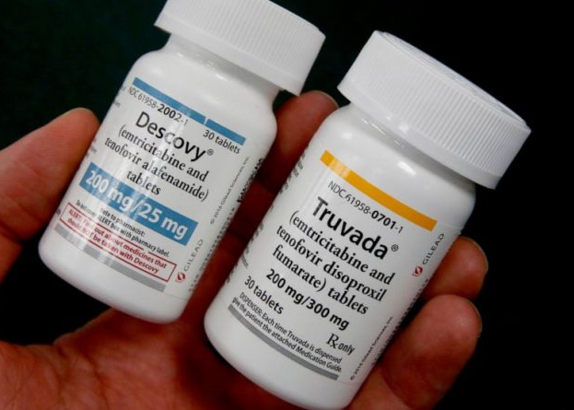
What is PrEP?
Pre-Exposure Prophylaxis: taking the medication to reduce the risk of contracting HIV before exposure occurs.
Once-daily pill taken by mouth, with or without food. Must take every day for maximum protection.
  Available only by prescription from a healthcare provider.
  The presence of the medication in your bloodstream can stop HIV from taking hold and spreading in your body.
Studies have shown that PrEP reduces the risk of getting HIV from sex by about 99% when taken daily (CDC, 2020).
  Condom use
  Among people who inject drugs, PrEP reduces the risk of getting HIV by at least 74% when taken daily (CDC, 2020).
Two medications licensed for PrEP: Descovy and Truvada.
Does not protect against pregnancy or other STIs.
Image courtesy of QueerForty.com

Slide 4
Why is PrEP Important?
New HIV diagnoses
  Highest rates in individuals aged 25-29.
  1/5 occur under the age of 24.
  50% have been treated for a sexually transmitted infection (STI) in the previous 6 months
May take up to 6 months of treatment for an HIV-positive partner to suppress their viral load to undetectable levels.

Slide 5
Two Medications Licensed for PrEP
Truvada (FTC/TDF)
For all adults and adolescents who are at risk of getting HIV-1 and weigh at least 77 pounds.
Not recommended for people with kidney function below a certain level.
Possible common side effects:
  Stomach pain
  Headache
  Weight loss
Uncommon side effects:
  Bone problems
    Bone pain, softening, or thinning (studies show no increase in bone fractures and will reverse after discontinuing PrEP (WHO, 2017)).
  Kidney problems and liver problems
Descovy (TAF/FTC)
For adults and adolescents who are at risk of getting HIV-1 and weigh at least 77 pounds.
  Not for use in people assigned female at birth who are at risk of getting HIV from vaginal sex, because its effectiveness has not been studied.
Possible common side effects:
  Stomach pain or nausea
  Diarrhea
  Headache
  Fatigue (tiredness)
Uncommon side effects: kidney problems and liver problems
Studies show less impact on kidney function and bone loss than Truvada.

Slide 6
Who Might Consider Taking PrEP?
People who are currently HIV-negative and:
  Inject drugs and/or share injection equipment with others
  Have sex with people who inject drugs
  Have sex with people who are HIV-positive (especially if they have an unknown or detectable viral load.)
  Have unprotected sex with people of unknown HIV status (anonymous partners)
  Exchange sex for drugs or money
  Engaged in vaginal or anal sex within the last 6 months and have had an STI within the last 6 months
PrEP
(CDC, 2020)

Slide 7
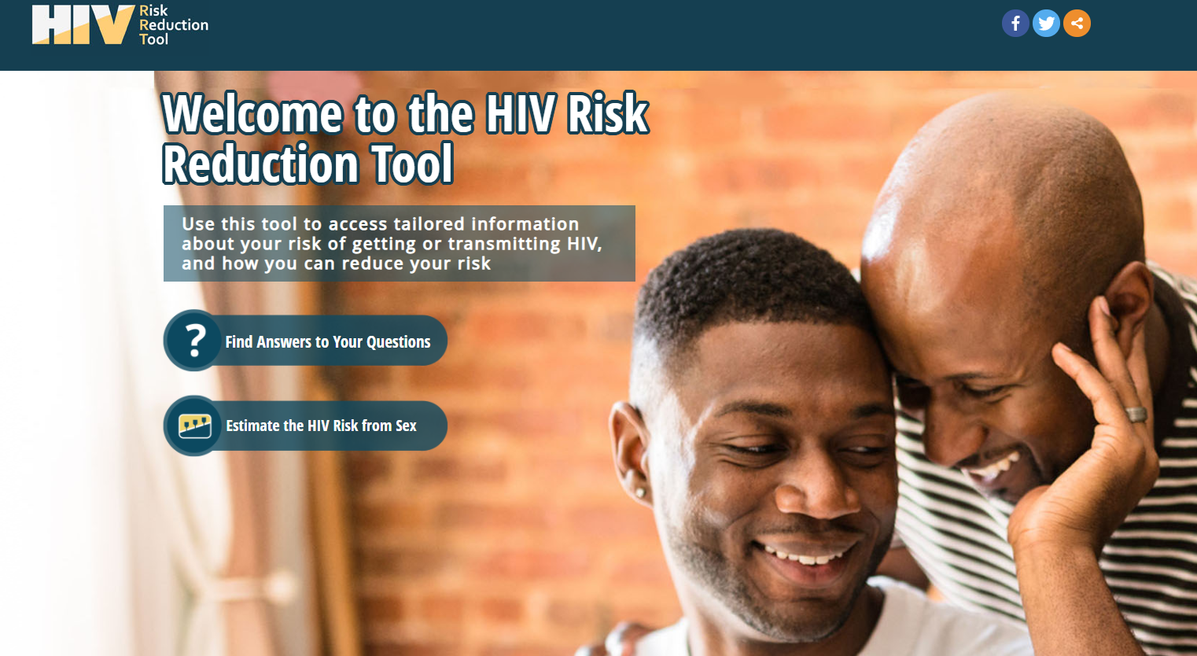
How to Talk to Your Healthcare Provider about Starting PrEP
Be clear about your interest in starting PrEP or in getting more information.
Bring with you a list of your medical history to your appointment:
  Past diagnoses, illnesses, surgeries
  Medications you take
  Supplements/herbals you take
Be honest about your sexual history and practices!
  HCP is there to help keep you safe, answer your questions, and not to judge.
  Wanting to start PrEP does not make you “dirty” or “promiscuous” or is anything to be ashamed of.
  If you’re nervous talking about your sex life, lead with that!
Ask about easy ways to add PrEP to your normal routine.
  Remember: PrEP is only as good as how consistently you take it!
Discuss other options for reducing your sexual risk factors.
Interrupt your provider when you need further clarification on a topic.
HIVRisk.CDC.gov

Slide 8

What to Expect When Starting PrEP
At your initial appointment, your healthcare provider might order some tests:
  HIV (must be HIV-negative to start PrEP)
  Hepatitis B
  Kidney function
  Liver function (baseline)
  Other STIs
  Pregnancy testing for those with childbearing potential
Assess your vaccine history.
Follow up with your healthcare provider every 3 months:
  Test for HIV
  Check kidney function (every 3 or 6 months.)
  Test for other STIs as recommended (every 3 or 6 months.)

Slide 9
Is PrEP Safe?
No significant health effects have been seen in people who are HIV-negative and have taken PrEP for up to 5 years (HIV.gov, 2020).
The side effects from taking PrEP are usually not serious and go away over time without stopping PrEP (HIV.gov, 2020).
  Most side effects resolve within a few days and almost never last more than a month (WHO, 2017).
More studies are needed on the topic of PrEP interfering with transgender hormone therapy, but there are no known drug conflicts or interactions between taking PrEP and hormones at the same time (CDC, 2020).
PrEP can be taken with all contraception methods (WHO, 2017).

Slide 10
Paying for PrEP
Most Medicaid plans and private insurance plans cover PrEP.
  May require prior authorization.
Medication assistance programs available to provide free medication or help with co-pays: (may not include assistance with clinic visit costs and lab fees)
  Getyourprep.com
  Gileadadvancingaccess.com
  Patient Access Network Foundation (PANFoundation.org)
  Patient Advocate Foundation (copays.org/funds/hiv-aids-and-prevention)
  Ready, Set, PrEP
Prepcost.org
  Cost calculator

Slide 11
PrEP During COVID-19:
A CDC Guidance Letter to Clinicians
CDC considers providing PrEP as an essential service.
Continue HIV testing every 3 months:
  Home specimen collection kits
    Oral self-swabbing when home collection kits are not an option.
  Telehealth/phone consultation visits with provider
    95% still able to get PrEP this way (Shaw, 2020).
HCP to consider 90-day supply of medication to reduce trips to pharmacy.
As of July 7th, 2020 (most recent data): no shortages or concern of shortages with medication used for PrEP (CDC, 2020).

Slide 12

Yes! You Can Get PrEP at Campus Health Center!
CHC can start you on PrEP and manage all your follow-up visits and testing.
  CHC offers one free visit per semester while enrolled as a WSU student.
  CHC also handles full primary care visits including vaccinations, physicals, and illness care.
  CHC offers flu vaccines for students at no out-of-pocket cost regardless of insurance status.
  Free STI testing for those who qualify.
  COVID-19 safety compliant.
Student organization through DOSO: Warriors PrEP & PEP Awareness.

Slide 13
Contact Us
Campus Health Center
5285 Anthony Wayne Drive
Detroit, MI 48202
(313) 577-5041
Email at CampusHealth@wayne.edu
Online at health.wayne.edu
Follow us on social media:
Twitter - @WSUCampusHealth
Facebook - @CampusHealthCenter
Instagram - @campushealthcenter
Now offering telehealth visits through telephone or webcam!
Notes:
Thank audience for listening to presentation. Offer contact information.

